Slide 1
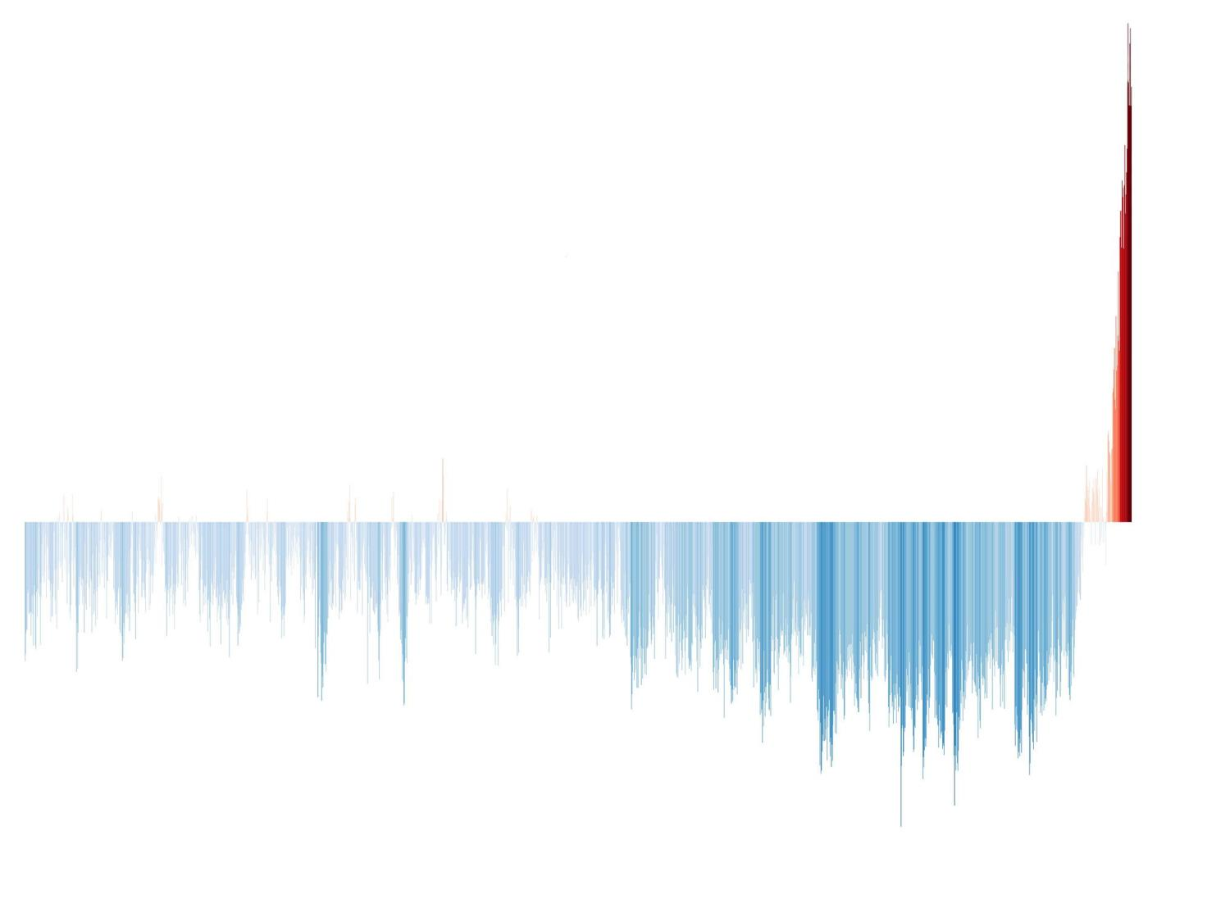
Climate Change in Education
How do we tell kids the truth about the future they face?
Notes:
Prepared for VicPhysics teachers conference Feb 2024 by Keith Burrows. Free to use in classrooms or schools. Feel free to email me with comments or questions: keithphysics@optusnet.com.au
Be sure to look at the ‘Notes’ section in normal view to see more comments and links to papers and sites mentioned.

Slide 2
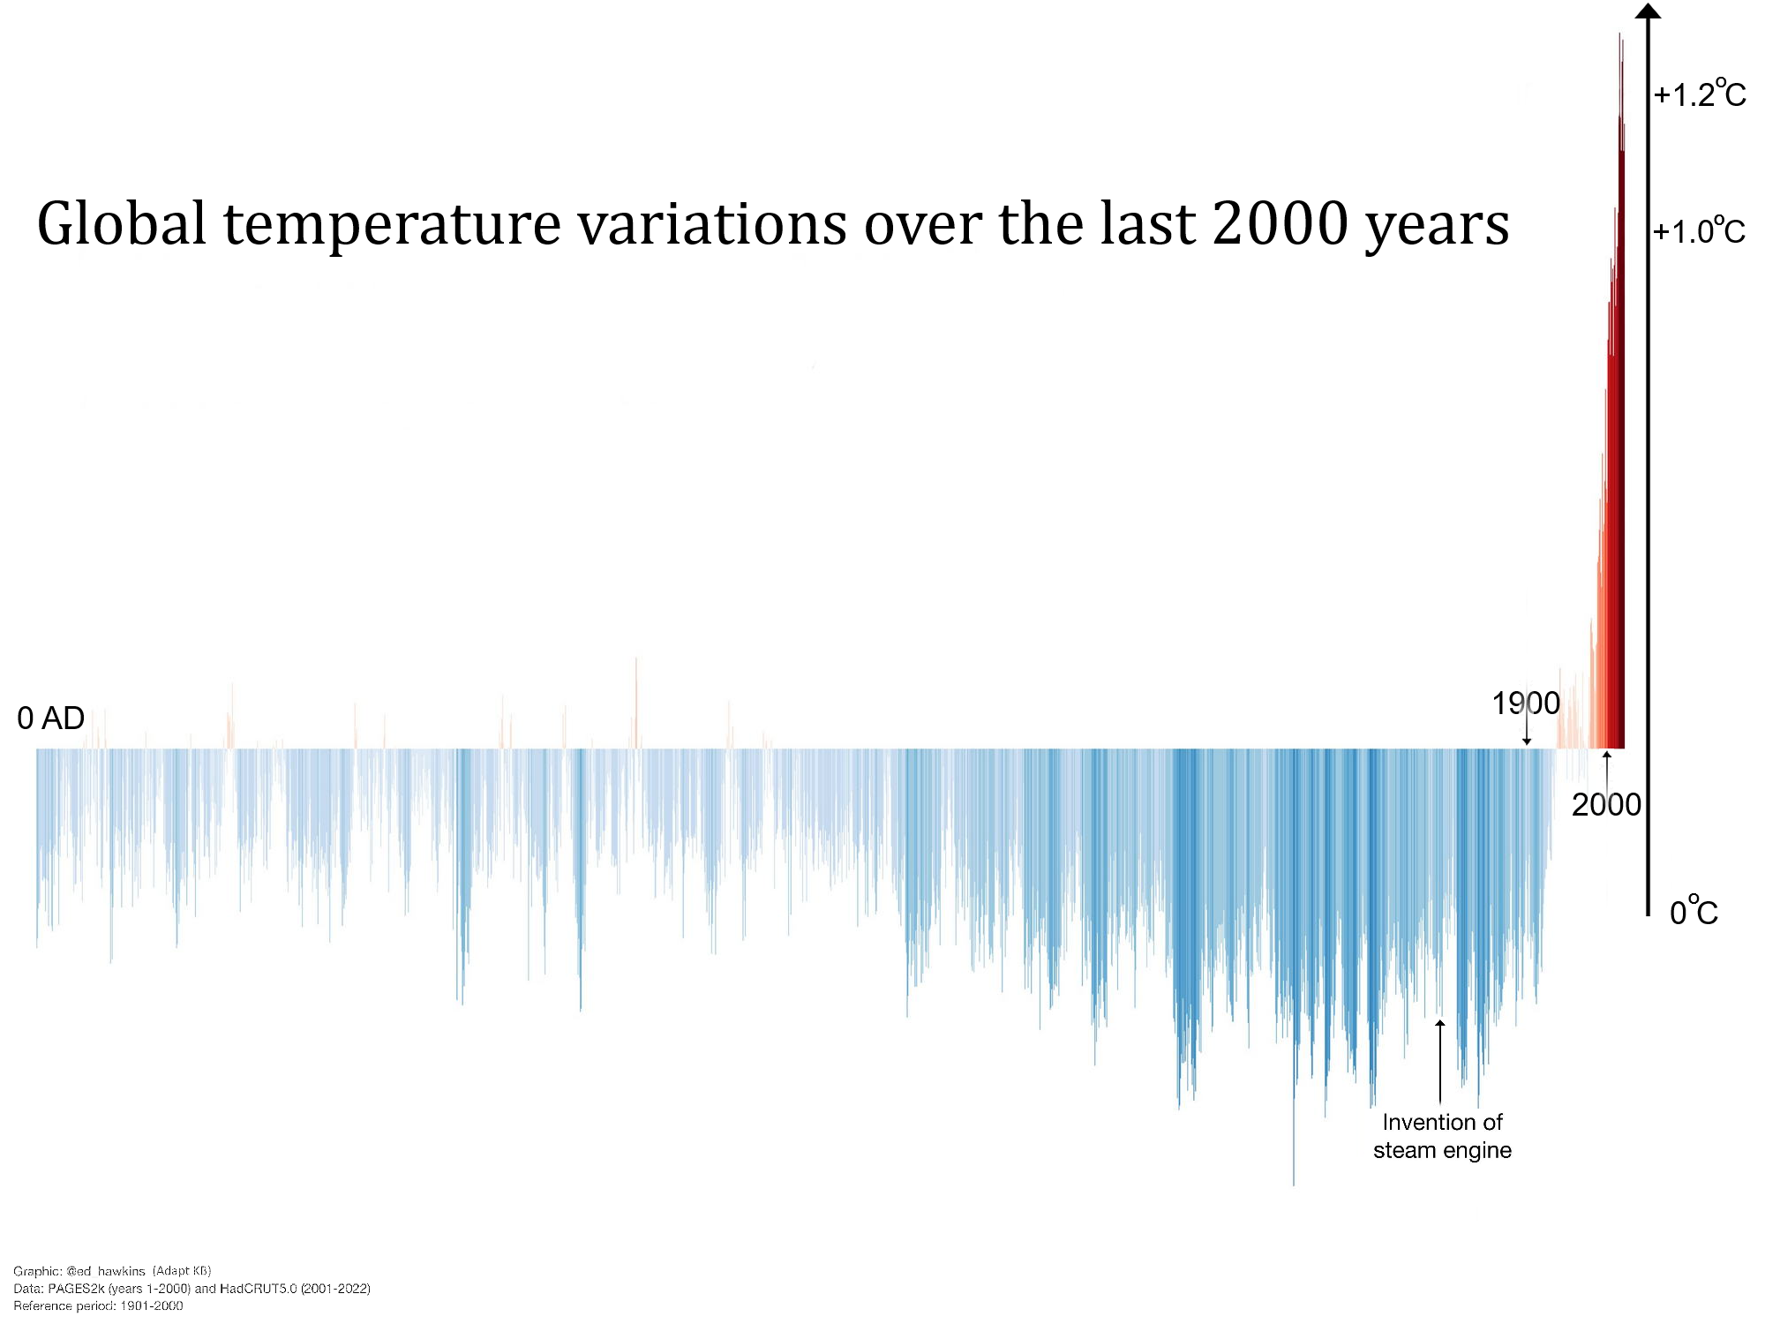
We are
here…
Ok, things are getting warmer – but does it really matter?
Notes:
Ed Hawkins @ed_Hawkins Global temperature variations over the last 2022 years. Burning fossil fuels is warming the planet, making extreme heatwaves & heavy rainfall more intense & more frequent with severe consequences for people & ecosystems.
Temperatures from tree rings and other proxies.

Slide 3
How do we tell kids the truth about the future they face?
The science is clear – they face a grim future unless governments take drastic action now.
What must be done?
What do kids know? How do they feel?
How can we inform them without scaring them?
This is not just a Physics issue!
Following are a few slides about the basic science. There is more about the science in my previous presentations on www.cs4s.net
Notes:
To go direct to those presentations click the following link:
https://www.cs4s.net/references.html
And then head down to “For Science Teachers and Probus people”
Please note: At last attempt the links were not working well. If the pptx’s won’t download please try again in the next few days.

Slide 4
Notes:
It’s important to realise that a lot of CO₂ goes in and out of the atmosphere, but have ADDED to the total. Now there is over 3 TRILLION tonnes. We have added over a TRILLION tonnes of CO2 to the atmosphere! Half as much again. Note that every year around 770 gtn CO2 go in and out of the biosphere, our 20 gtn is “only” about 3% of that – BUT… it ADDS up every year!
CO2 from land is increasing because we are clearing land and planting less
CO2 going into the ocean from the atmosphere is decreasing because more is going in from our emissions (decreasing the pH) and the ocean is warming. CO2 level now almost 420ppm
(Ocean is warming but concentration of CO2 in the atmosphere is increasing at a faster rate.)

Slide 5
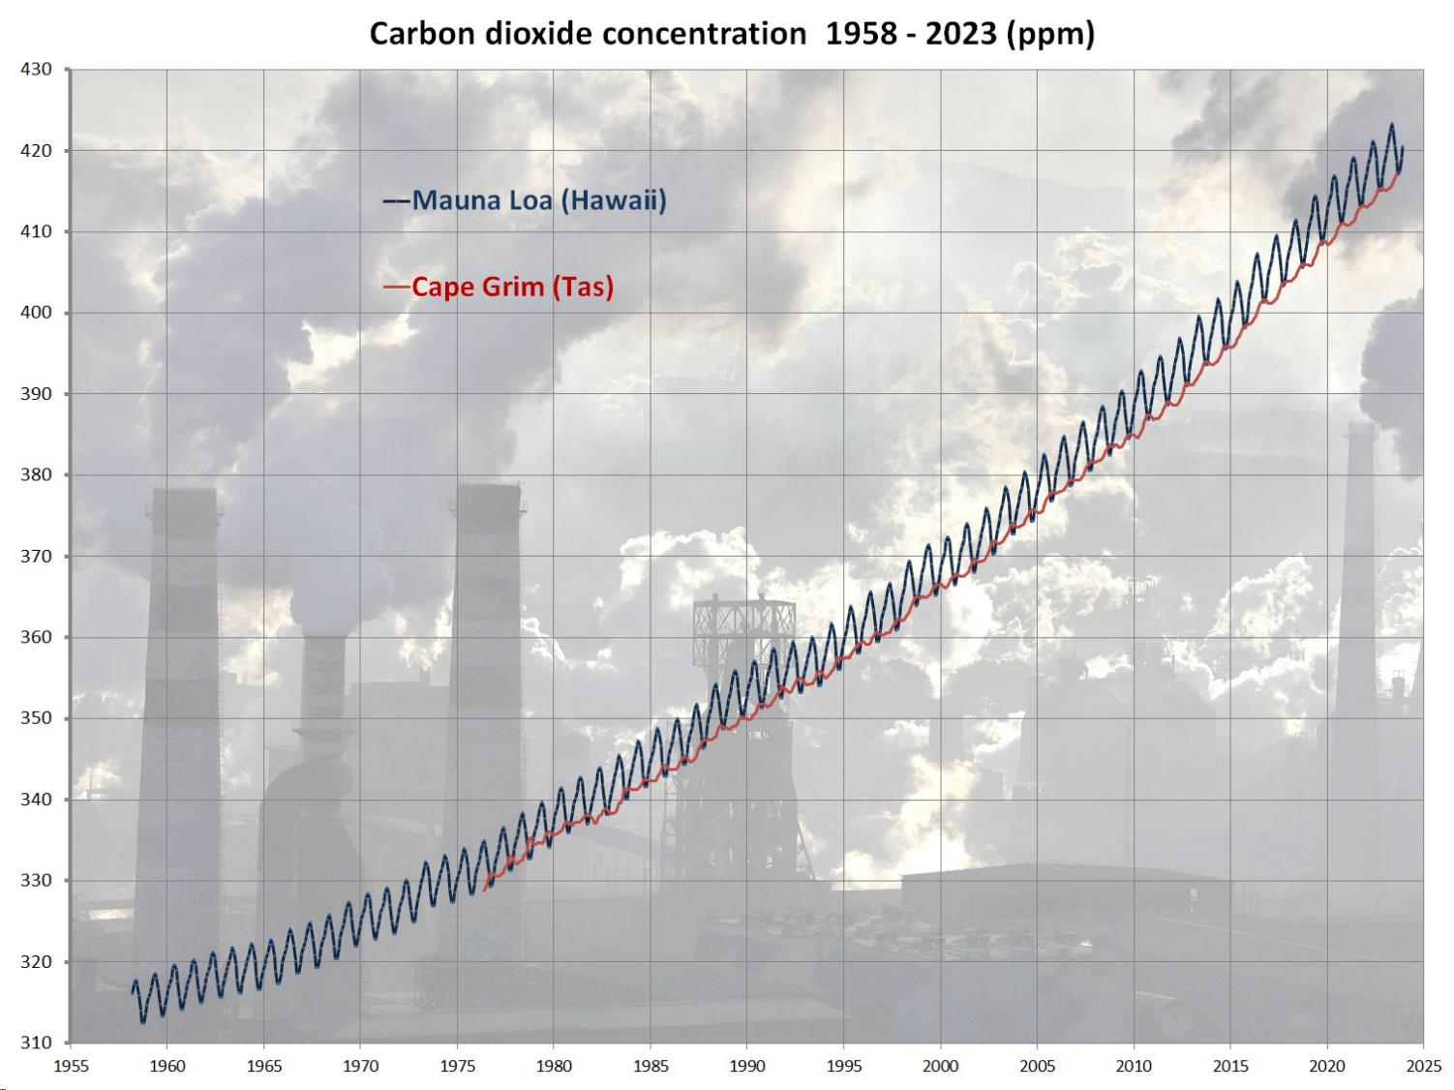
423 ppm
May 2023
400 ppm = 0.04%
Rate of increase is STILL increasing!
Notes:
Pre-industrial CO2 was about 280 ppm. There is no reasonable doubt that the reason for this rise is emissions from burning fossil fuels. Problem is that even if we can keep our emissions from rising there is a large part of the world which is trying to catch up to us and their emissions are rising using the curve to bend upwards. Furthermore, even if we stopped adding CO2 now it would stay high at this level for quite a few decades.

Slide 6
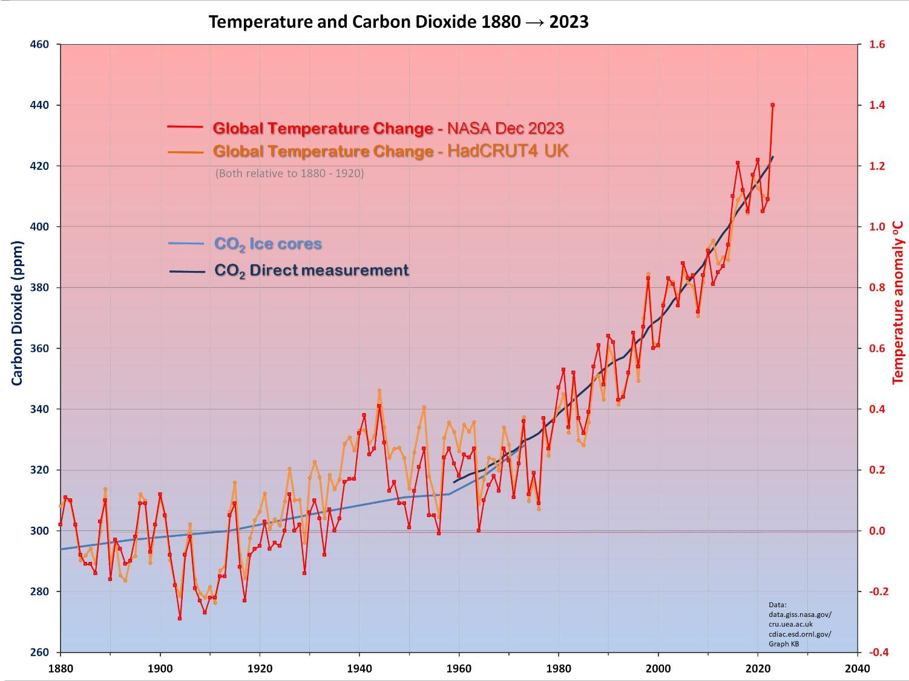
2030
+1.5
El Niños
La Niñas
Notes:
Clearly there IS a connection between CO2 and temperature… as we expect.
2021 was the hottest ever La Niña year and 2023 was the hottest ever year! Even though it was not a particularly strong El Niño.
Temperatures (red, orange) have gone up pretty much in line with the CO2 (blue – from ice cores and more recently direct measurement) as expected.
It’s not nice to consider what the next El Niño might be like!
Very easy to believe that it will not be possible to limit temperatures to +1.5 deg by 2030, much less 2050.

Slide 7
Looks like we’ve avoided another strong El Niño fortunately – but watch out for the next one!
2016
1998
Last La Niña was three years from July 2020 to June 2023 It brought us mild weather – but the northern hemisphere was not so lucky!
NB: Previous highs were in El Niños 1998 and 2016 … and 2023!
Notes:
This previous ‘mild’ El Niño brought us the world’s highest average temperature – significantly higher than 1998 and 2016, so what will the next ‘strong’ El Niño bring?!
https://www.ncei.noaa.gov/access/monitoring/enso/soi

Slide 8
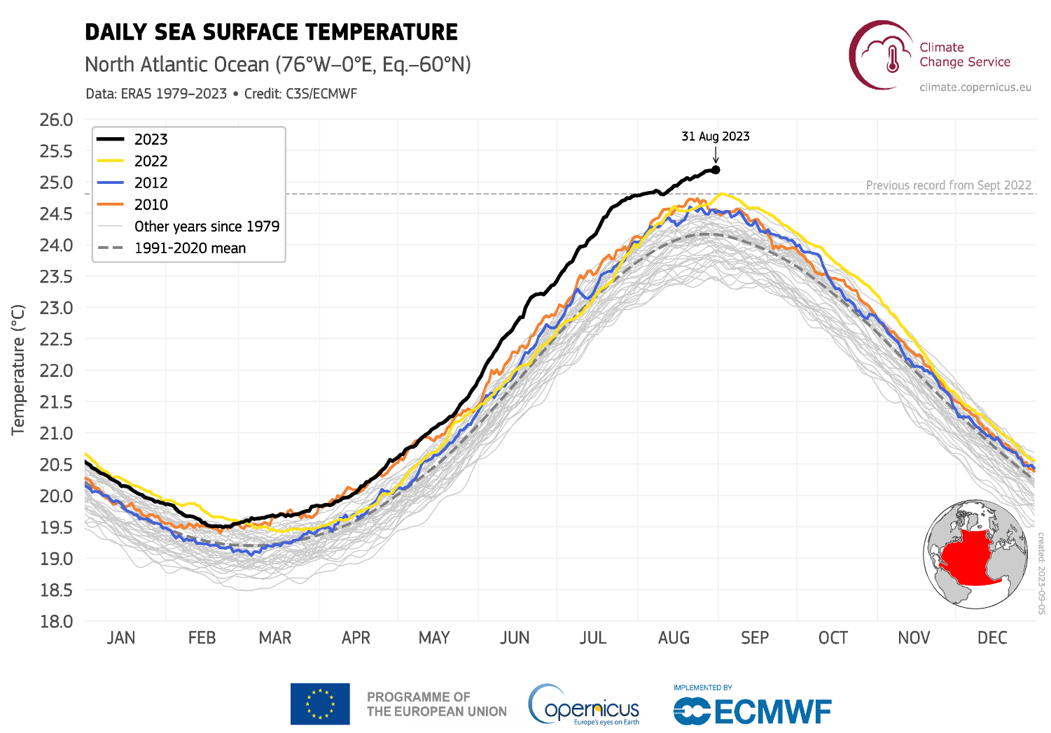

Slide 9
Looking at the past – the big picture
Pliocene
CO₂ ~400ppm
Sea levels
~30 m higher
LIG CO₂~280ppm 125,000 yr ago About +1ºC
Sea ~8m higher
Holocene
10,000 yrs of stable climate
+3°C
+2°C
+1ºC
LIA & MWP
Human civilisation
Notes:
The greenhouse effect is not just some “computer theory”, we can see it in action in “recent” geological history.
The fact is that the Earth’s temperature has varied a lot in geological history – but not in ours so we don’t have a feel for what can happen!
This is probably the most complicated graph in the (science) presentation, but perhaps also the most important! We find it hard to imagine a different climate because we have never experienced one – in all human history!
Human civilization has developed in the last 10,000 years because the climate was stable! Two periods of interest…
LIG Last InterGlacial 150,000 – 100,000 yr ago. CO2 similar to pre-industrial (280 ppm) temperatures only about 1 deg higher (ie about same as now!) but sea levels around 6 – 9 m higher than now.
Pliocene, 2-3 million yr ago – similar to now CO2, only a couple of degrees warmer, but sea level about 25 – 40 m higher, little polar ice, …. Etc!! ??

Slide 10
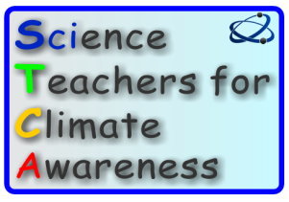
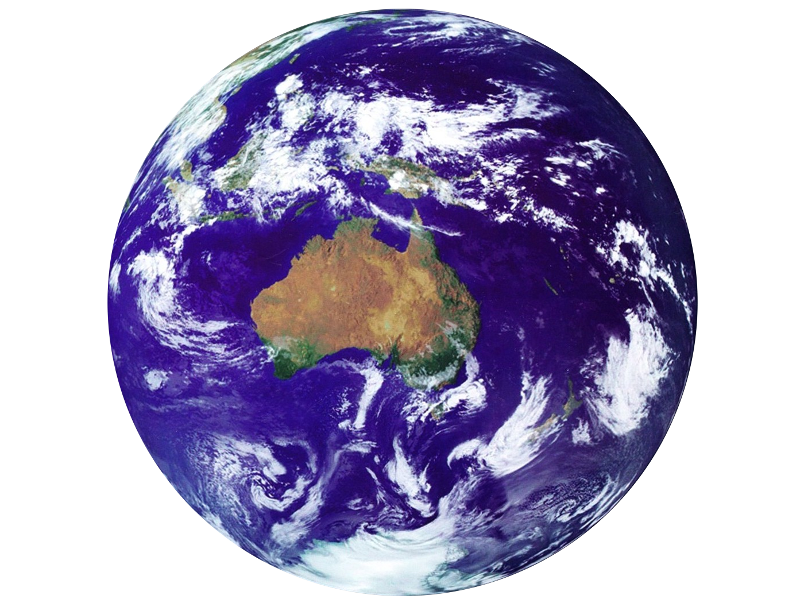
Climate Change
More about the science in my older presentations
Does it really matter?
Notes:
This is a revised version for next time – but needs to be shorter!
This was based on version for National Seniors June 15 Feb 15 Greensborough. It was too long – too rushed! Got to “What can we do” but too rushed. Better to design for 45 min and don’t rush. This is a huge topic and we can only touch on bits of it in an hour. I am going to concentrate on what the problem is and why we need to act rather than on what to do about it. The solutions are actually obvious – the problem is that many people (think Fed govt) don’t seem to thing we need to do anything much. So the urgent need is for all of us to become aware and to convince others of the need for serious action – not just the greenwashing that we are getting from Morrison and co.

Slide 11
Climate Science 4 Sceptics
Notes:
Go to www.cs4s.net for more on the science

Slide 13
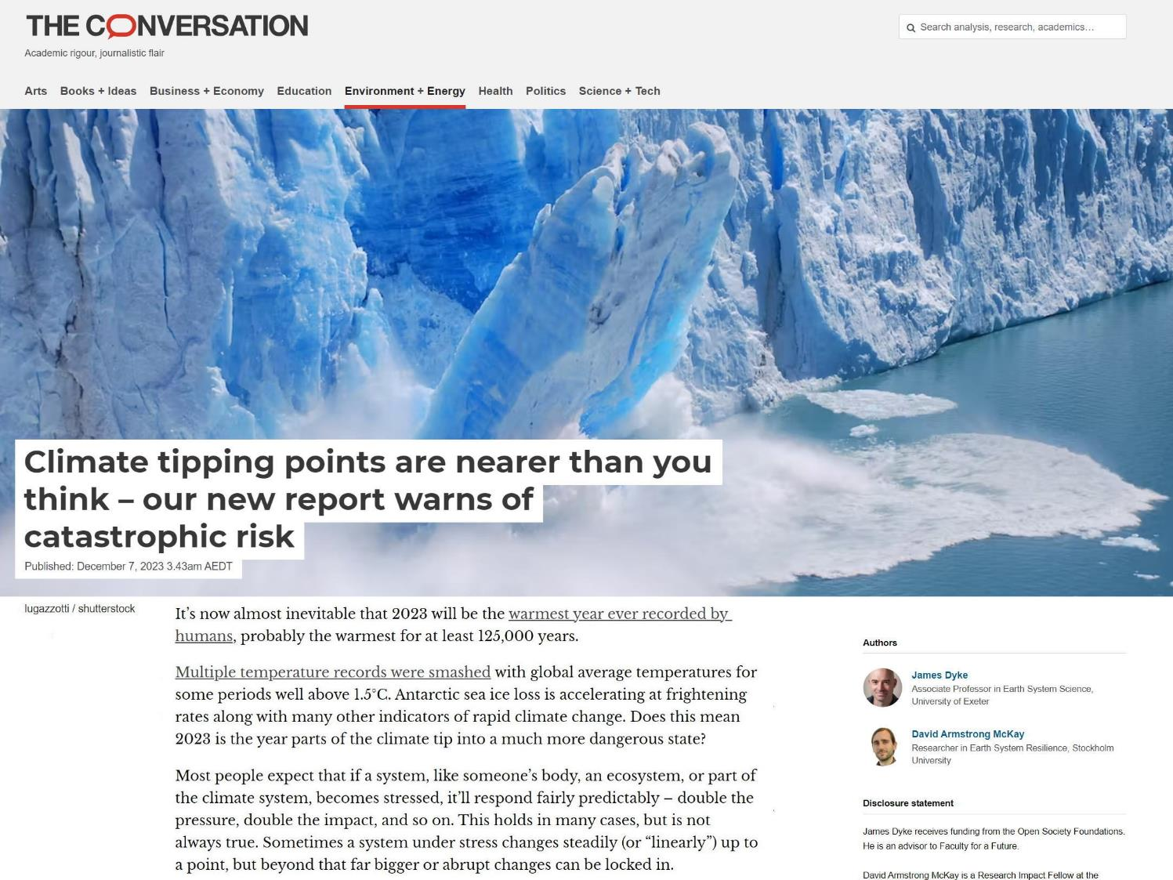
Sometimes a system under stress changes steadily (or “linearly”) up to a point, but beyond that far bigger or abrupt changes can be locked in.
Notes:
Since the earlier presentations more has been published on tipping points, so here are a few resources on that.

Slide 14
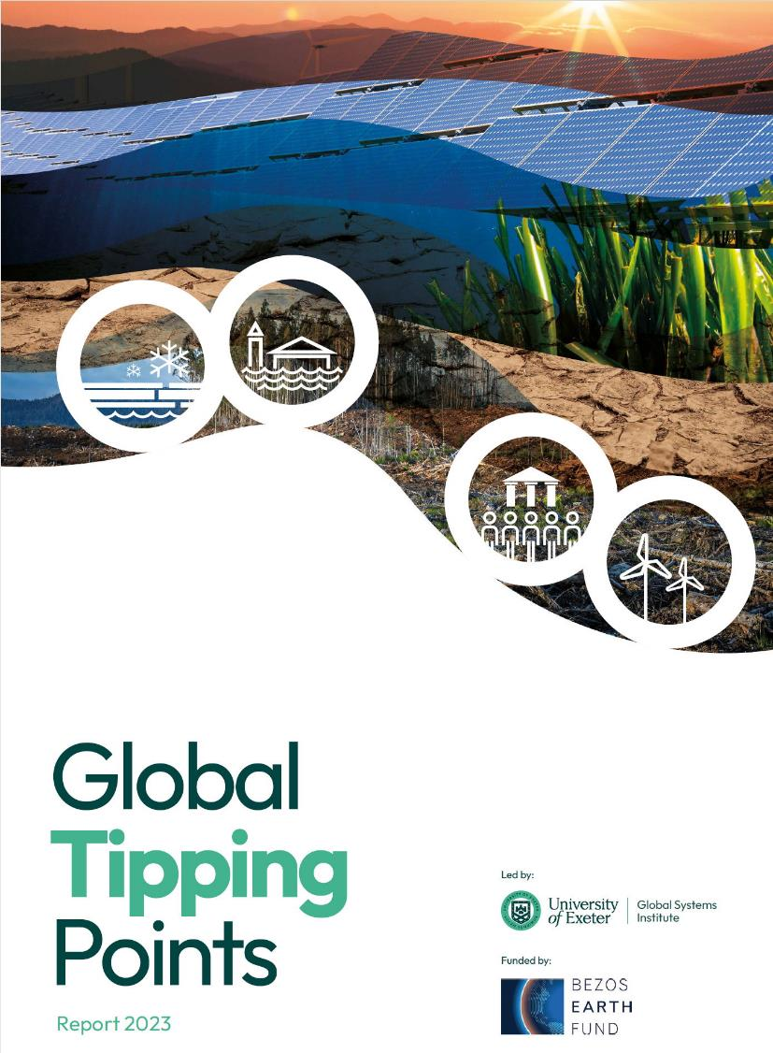
A valuable resource on the danger of tipping points
Just a few examples from this report....
https://global-tipping-points.org/
Notes:
https://global-tipping-points.org/
From the Intro: Harmful tipping points in the natural world pose some of the gravest threats faced by humanity. Their triggering will severely damage our planet’s life-support systems and threaten the stability of our societies.
For example, the collapse of the Atlantic Ocean’s great overturning circulation combined with global warming could cause half of the global area for growing wheat and maize to be lost. Five major tipping points are already at risk of being crossed due to warming right now and three more are threatened in the 2030s as the world exceeds 1.5°C global warming.
The full damage caused by negative tipping points will be far greater than their initial impact. The effects will cascade through globalised social and economic systems, and could exceed the ability of some countries to adapt. Negative tipping points show that the threat posed by the climate and ecological crisis is far more severe than is commonly understood and is of a magnitude never before faced by humanity.

Slide 15
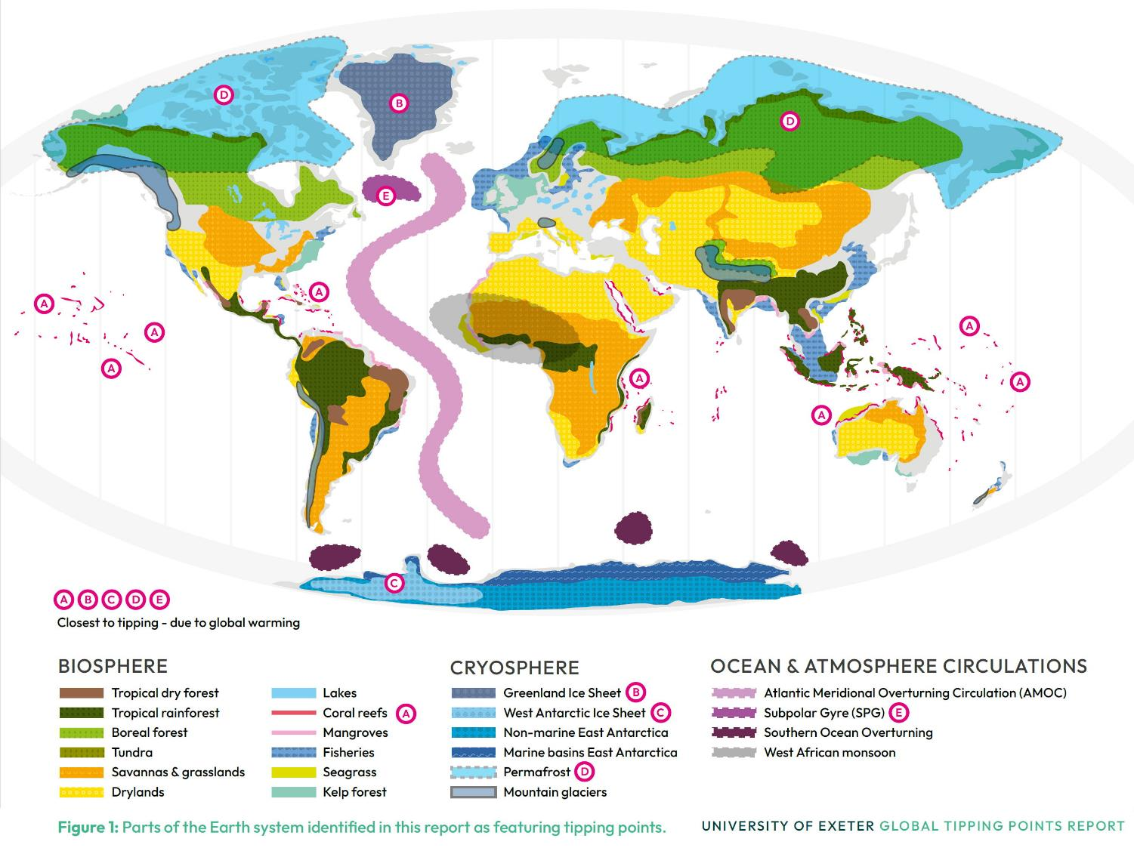

Slide 16
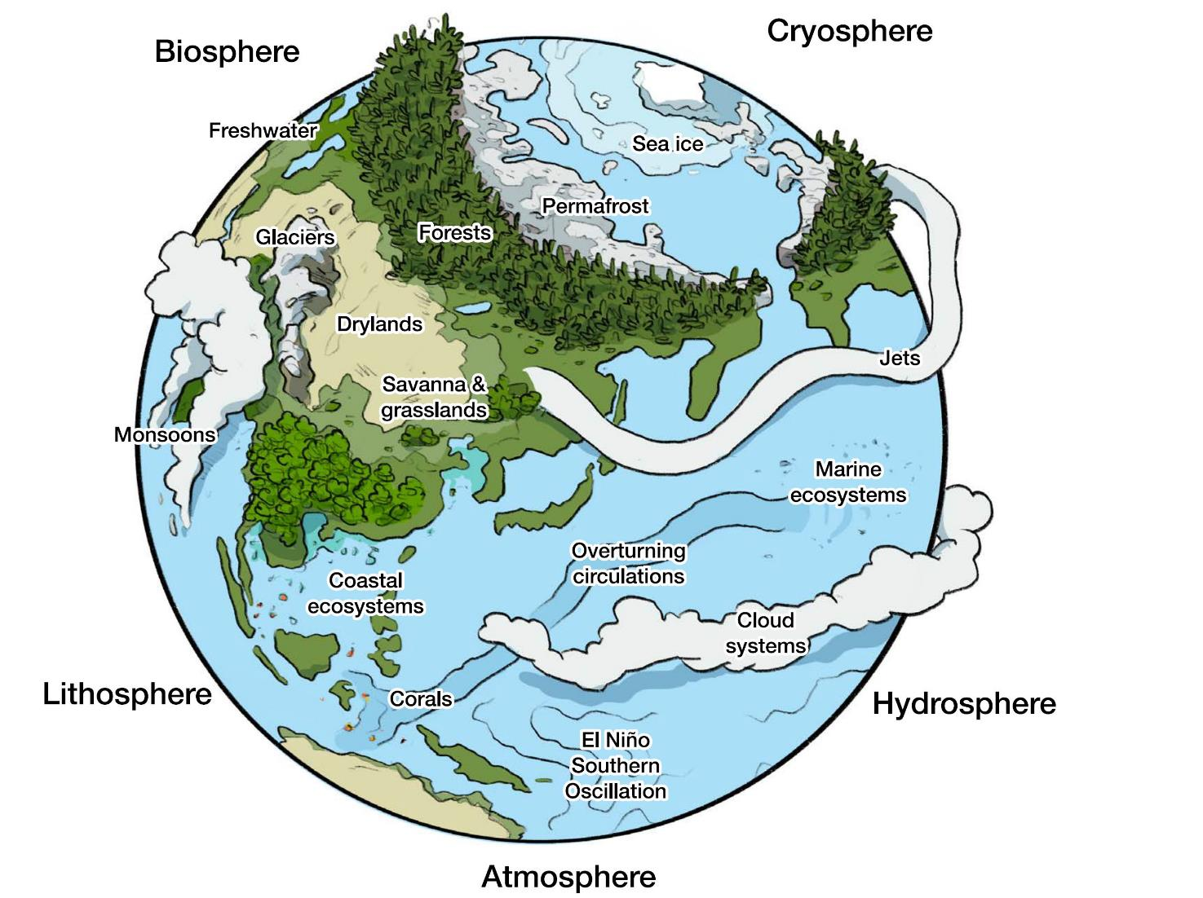

Slide 17
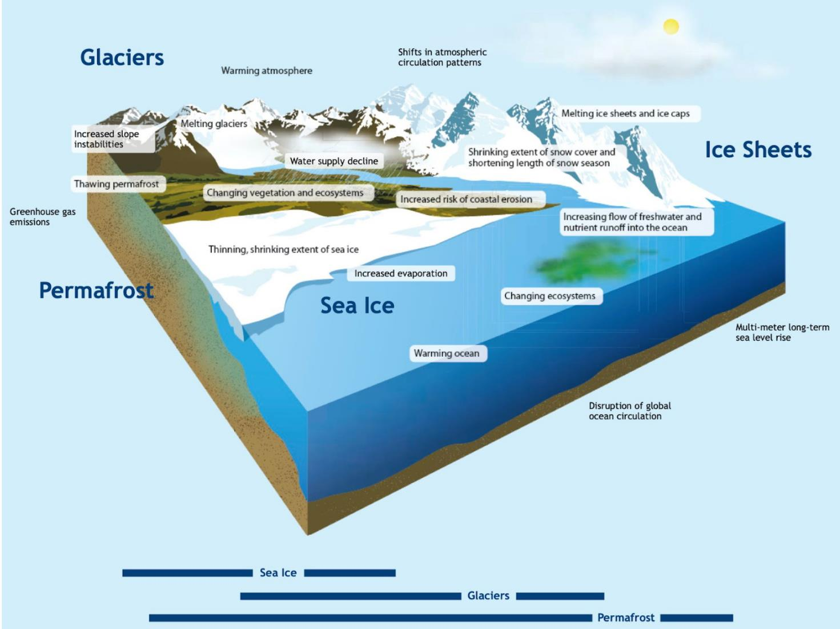

Slide 18
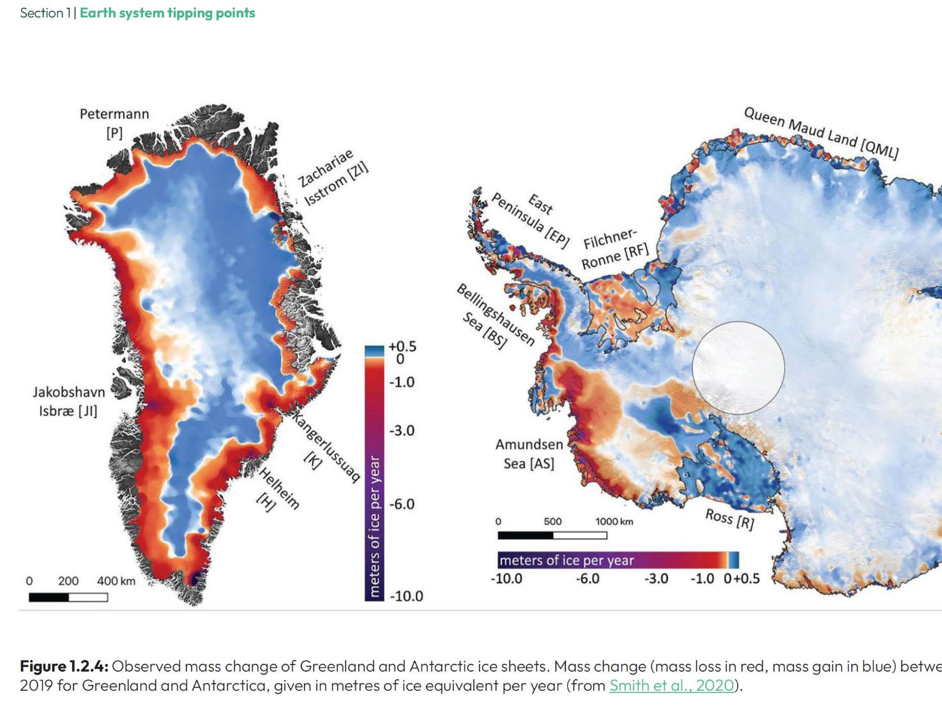
GTP report-Fig1.2.1

Slide 19
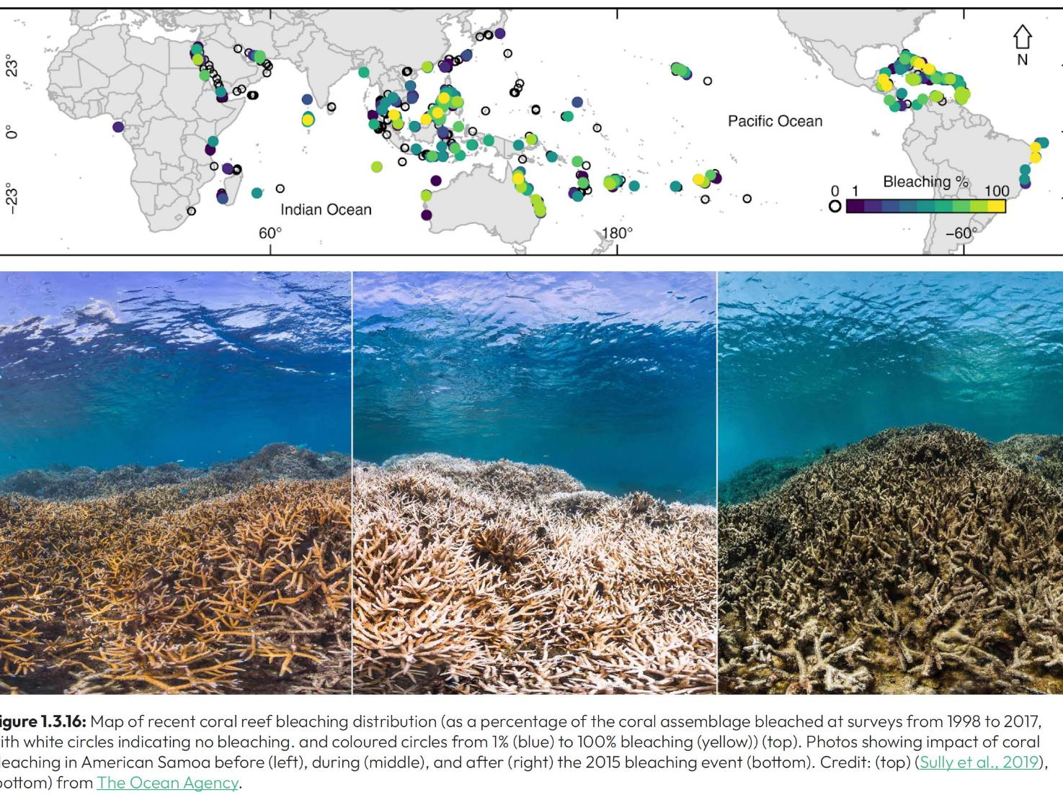
GTP report-Fig1.2.1

Slide 20
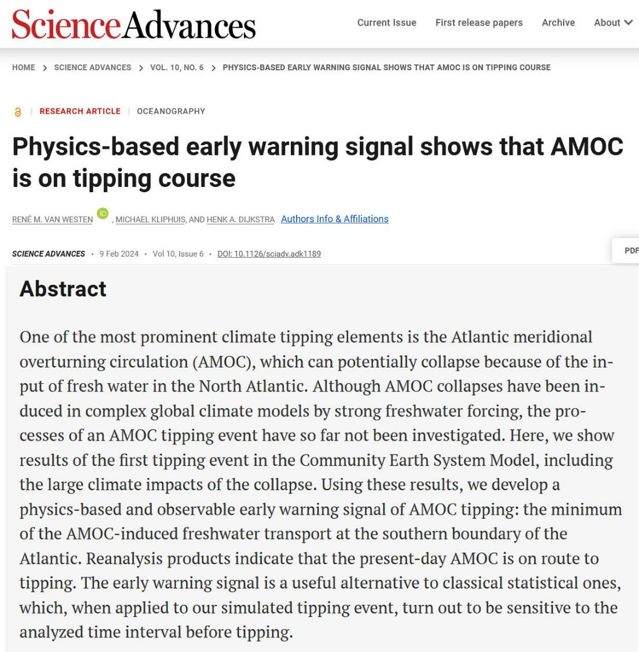
AMOC
Atlantic Meridional Overturning Circulation
Notes:
https://www.science.org/doi/10.1126/sciadv.adk1189
Physics-based early warning signal shows that AMOC is on tipping course René M. van Westen*, Michael Kliphuis, Henk A. Dijkstra
One of the most prominent climate tipping elements is the Atlantic meridional overturning circulation (AMOC), which can potentially collapse because of the input of fresh water in the North Atlantic. Although AMOC collapses have been induced in complex global climate models by strong freshwater forcing, the processes of an AMOC tipping event have so far not been investigated. Here, we show results of the first tipping event in the Community Earth System Model, including the large climate impacts of the collapse. Using these results, we develop a physics-based and observable early warning signal of AMOC tipping: the minimum of the AMOC-induced freshwater transport at the southern boundary of the Atlantic. Reanalysis products indicate that the present-day AMOC is on route to tipping. The early warning signal is a useful alternative to classical statistical ones, which, when applied to our simulated tipping event, turn out to be sensitive to the analyzed time interval before tipping.

Slide 21
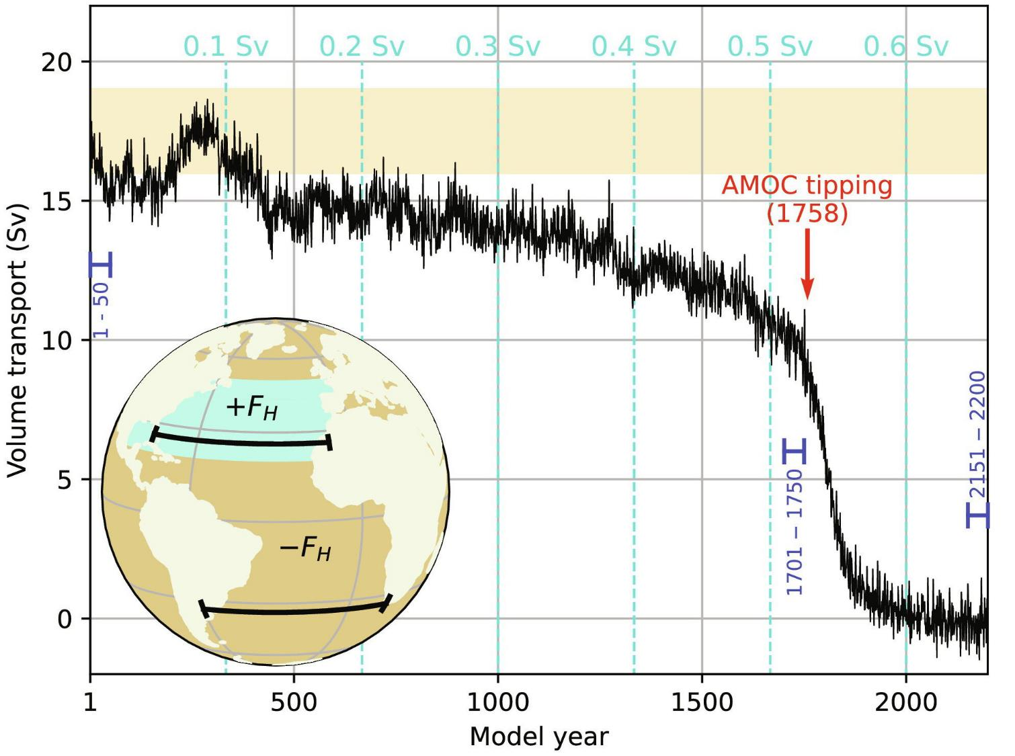
Notes:
Modelling shows that there are slow changes followed by a rapid – and unstoppable – change
From the paper in the previous slide.

Slide 22
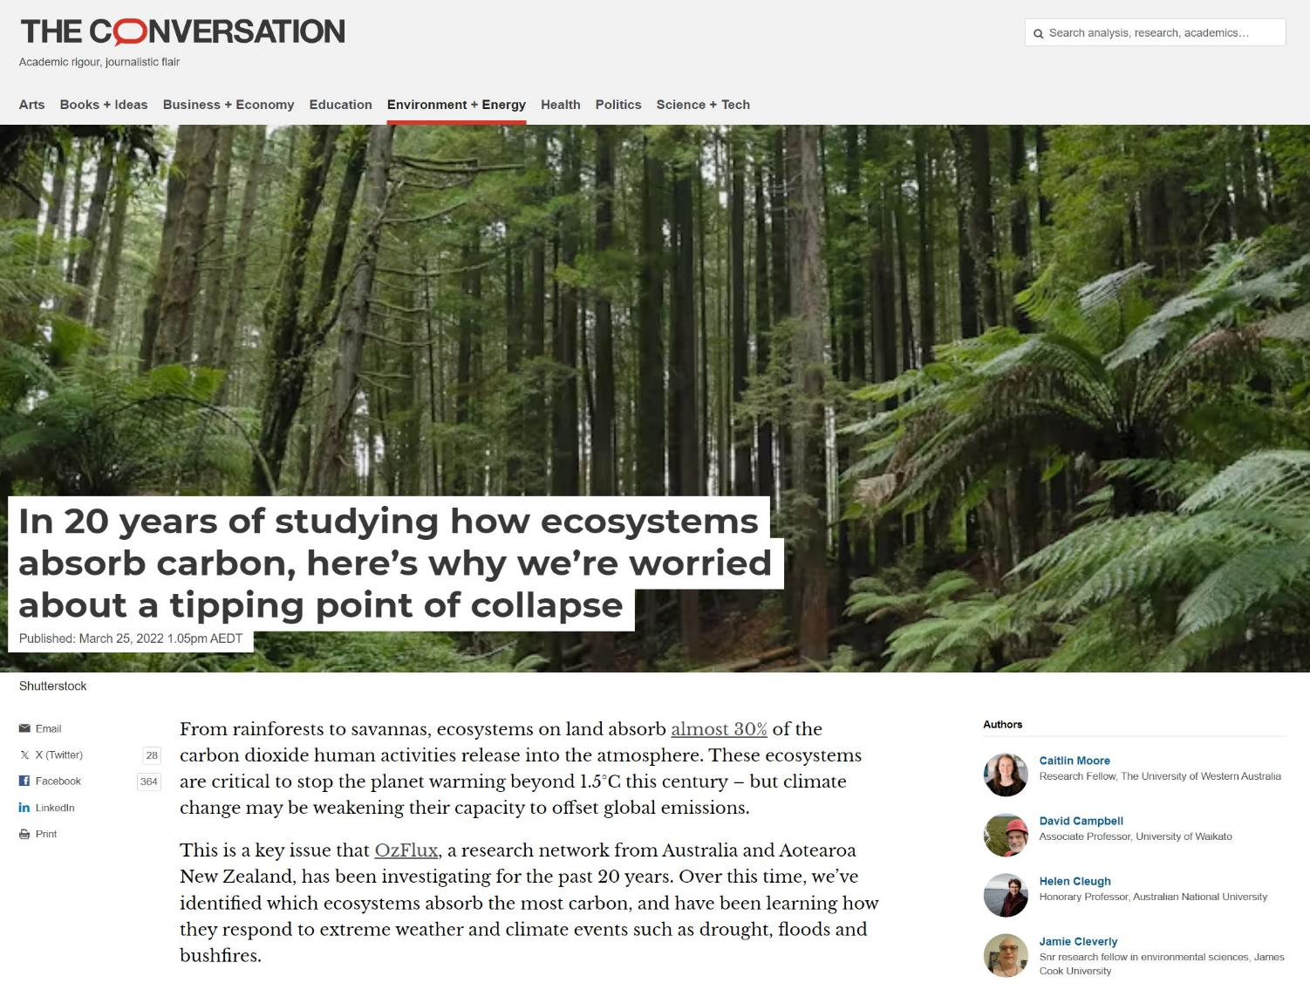
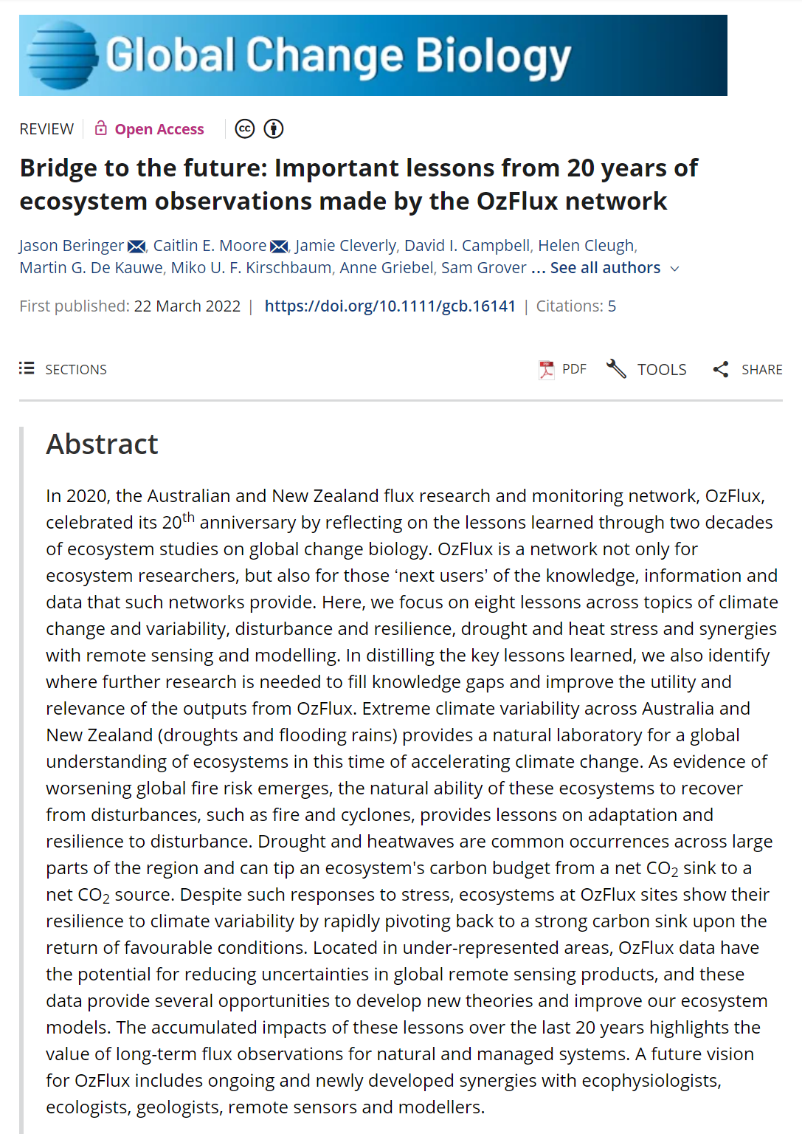
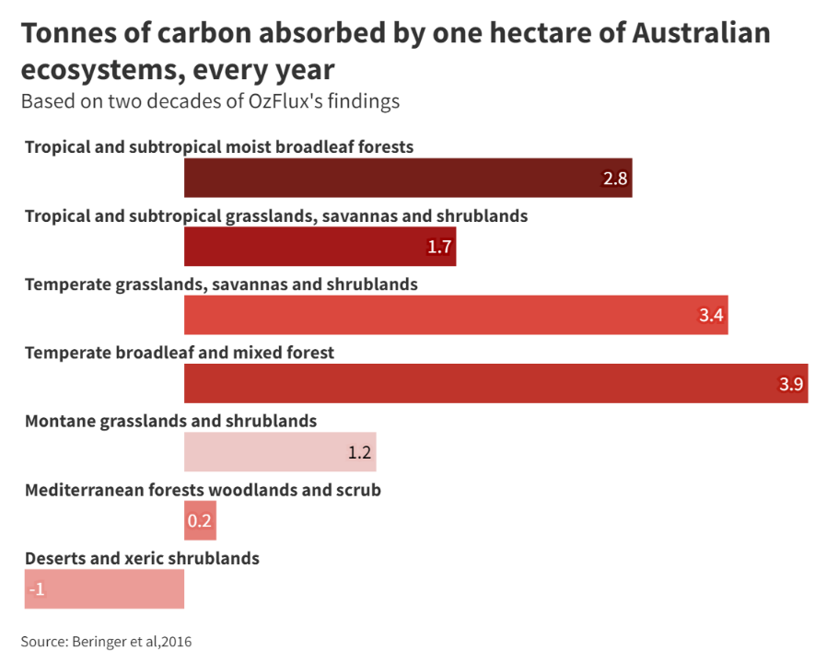
Notes:
https://theconversation.com/in-20-years-of-studying-how-ecosystems-absorb-carbon-heres-why-were-worried-about-a-tipping-point-of-collapse-179554
https://onlinelibrary.wiley.com/doi/full/10.1111/gcb.16141

Slide 23
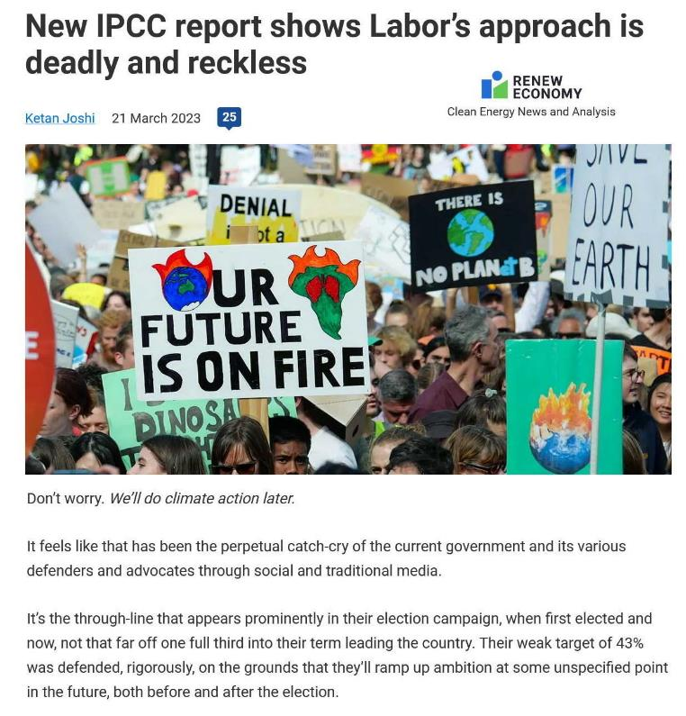
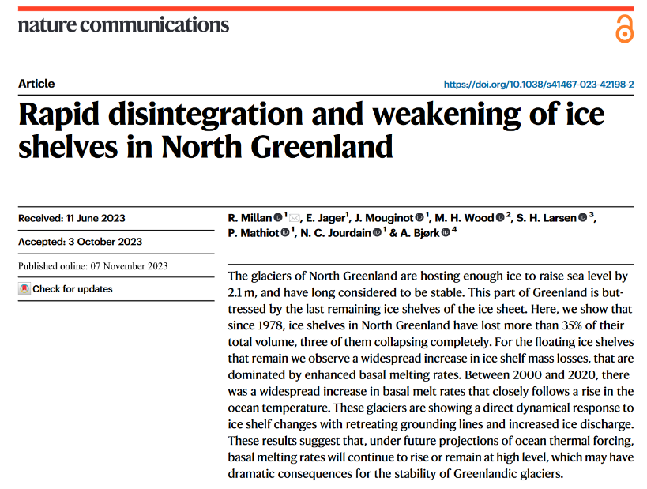
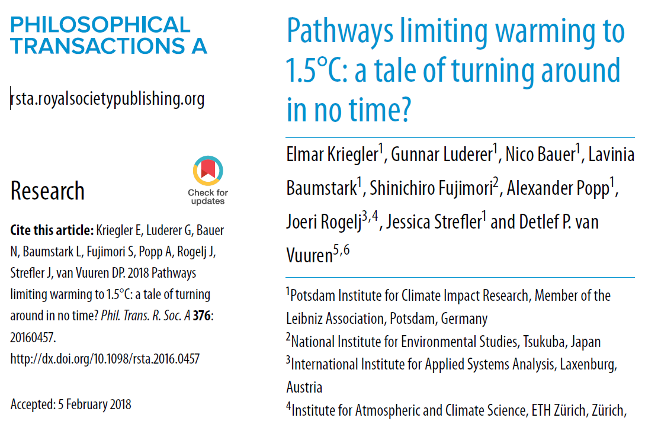
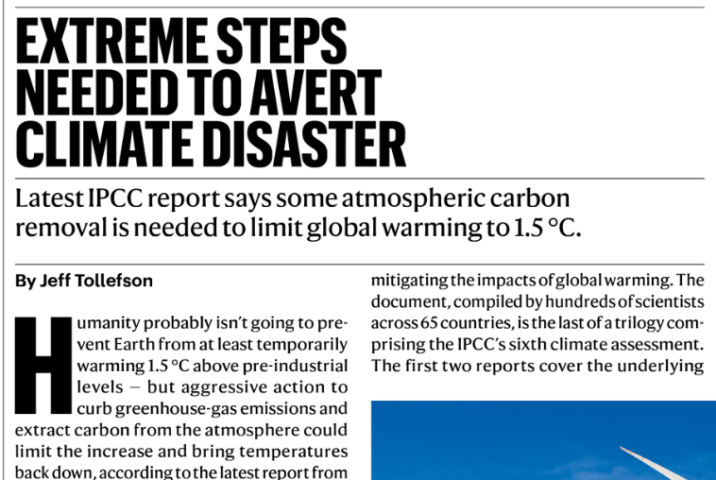
Notes:
https://www.nature.com/articles/s41467-023-42198-2
https://royalsocietypublishing.org/doi/10.1098/rsta.2016.0457

Slide 24
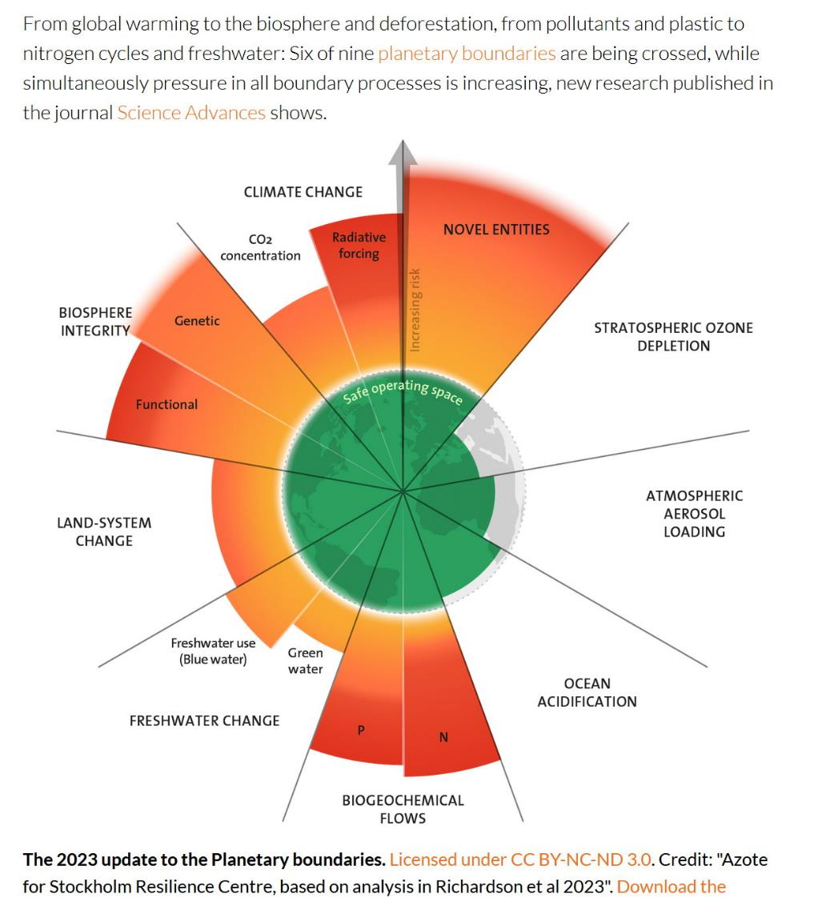
The gloomy news just goes on and on

Slide 26
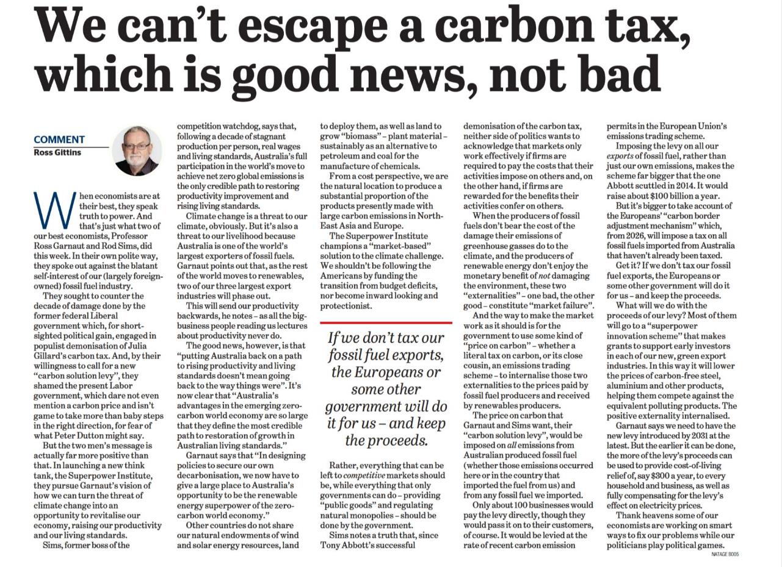
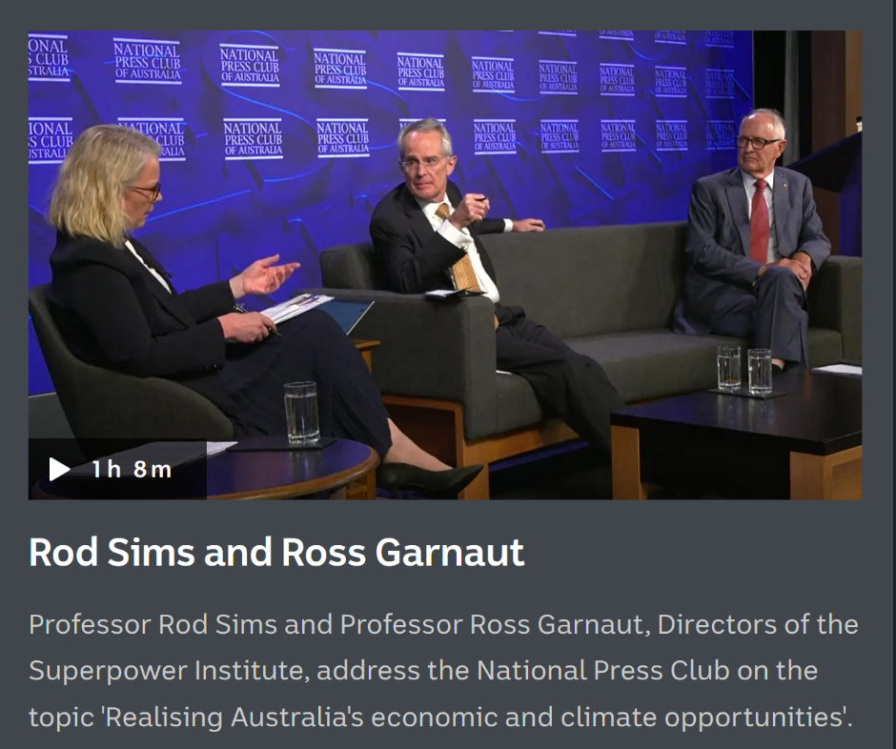
Meanwhile, in the land of Oz
The Age 17 Feb 2024

Slide 27
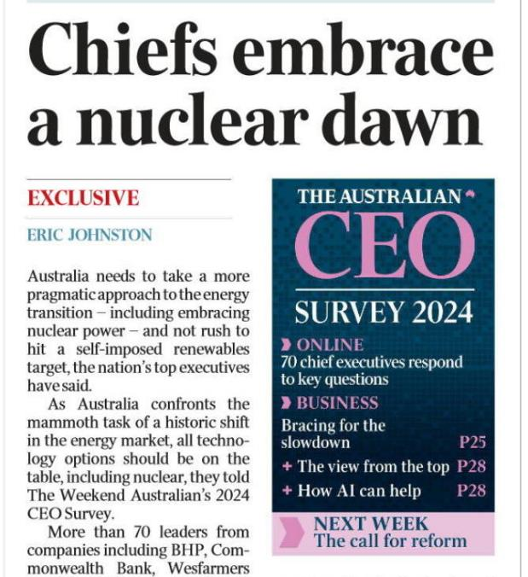
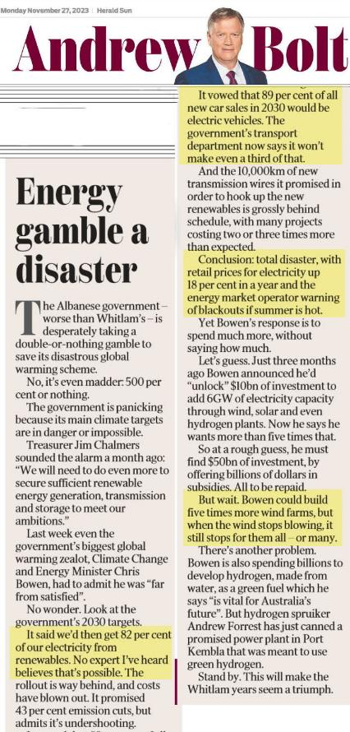
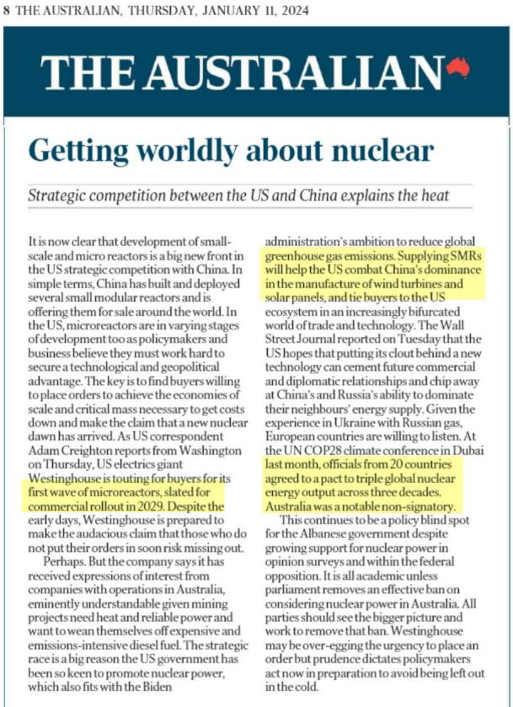
Meanwhile the Murdoch media push nuclear and oppose renewables
Graham Lloyd 15 Dec 2023
“comparable” ????
Notes:
Comparable countries!!! Haven’t they noticed the solar and wind potential??

Slide 28
We have some of the best potential for solar power in the world!
Notes:
Compare us with Europe! Most of the EU has a greater proportion of renewable than we do!!!

Slide 29
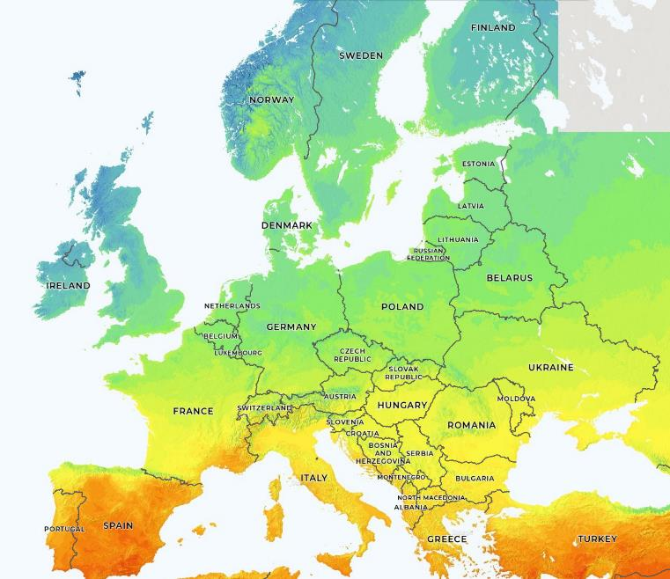
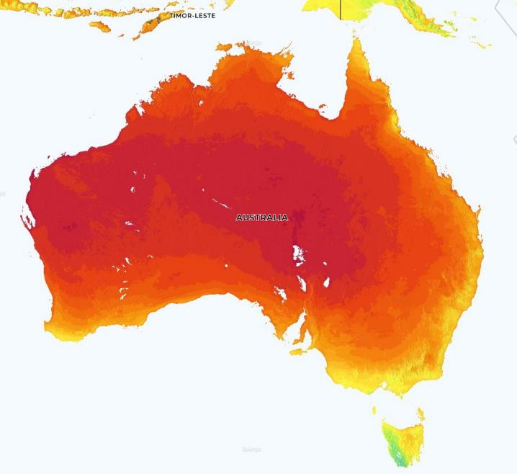
500 million people 25 million people
We could be a world leader in renewable power!

Slide 30
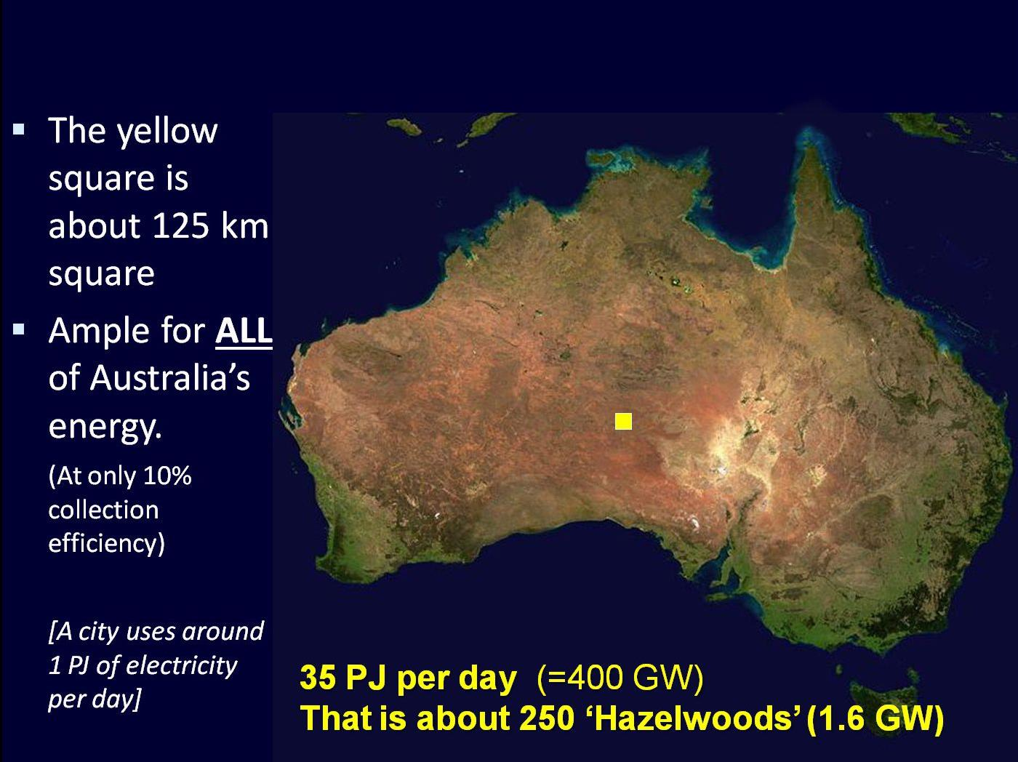
But we have HUGE solar potential
0.13% of our land area
Notes:
We have the potential to process huge amounts of iron ore and then sell ‘green steel’ to China
And boost our economy!

Slide 31
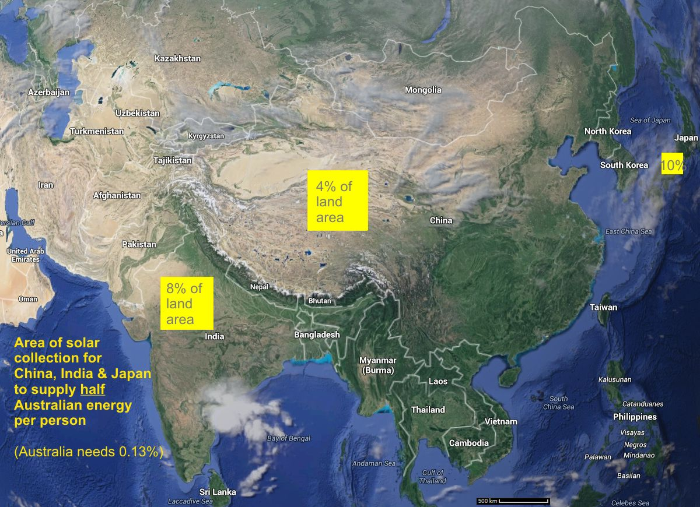
Much more difficult for most countries
Notes:
China will have huge problems supplying it’s own population with renewable energy, much less using huge amounts for steel making. So, where better to process iron ore to steel…

Slide 33
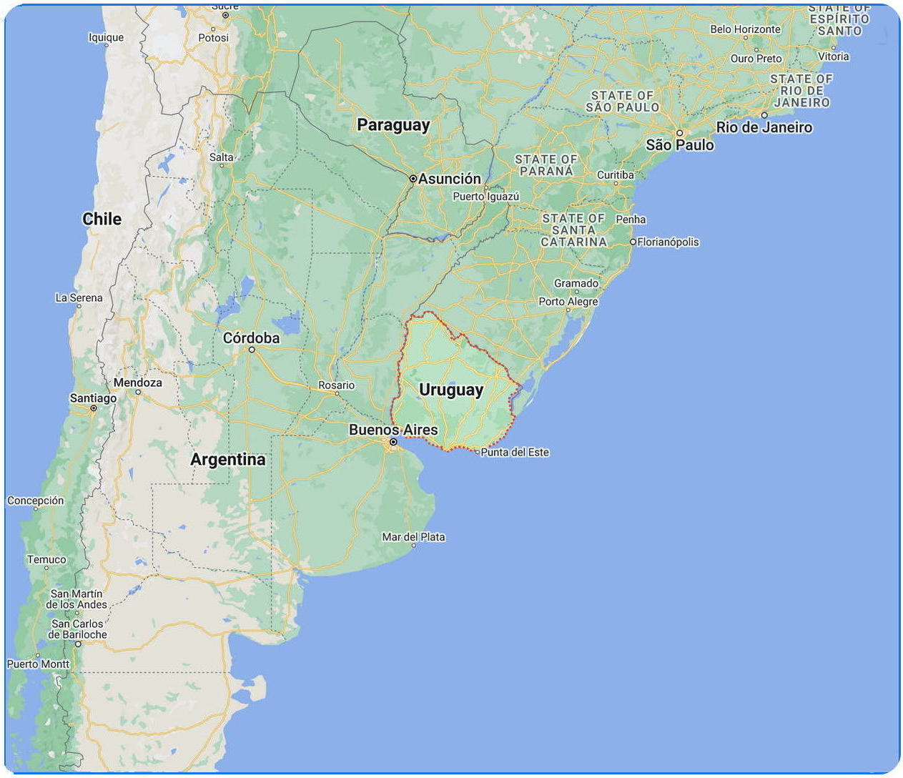
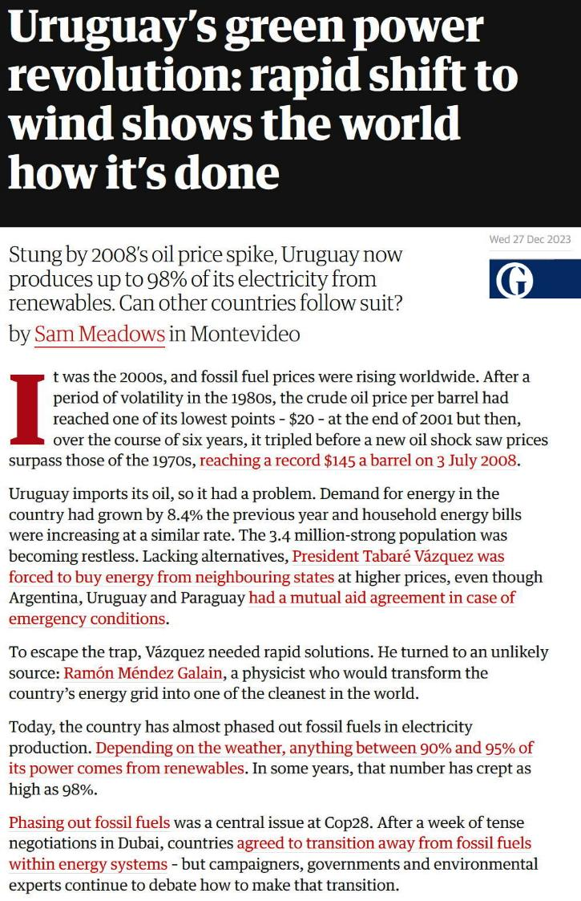
Uruguay:
19 people/sq km
Australia:
3.5 people/sq km

Slide 34
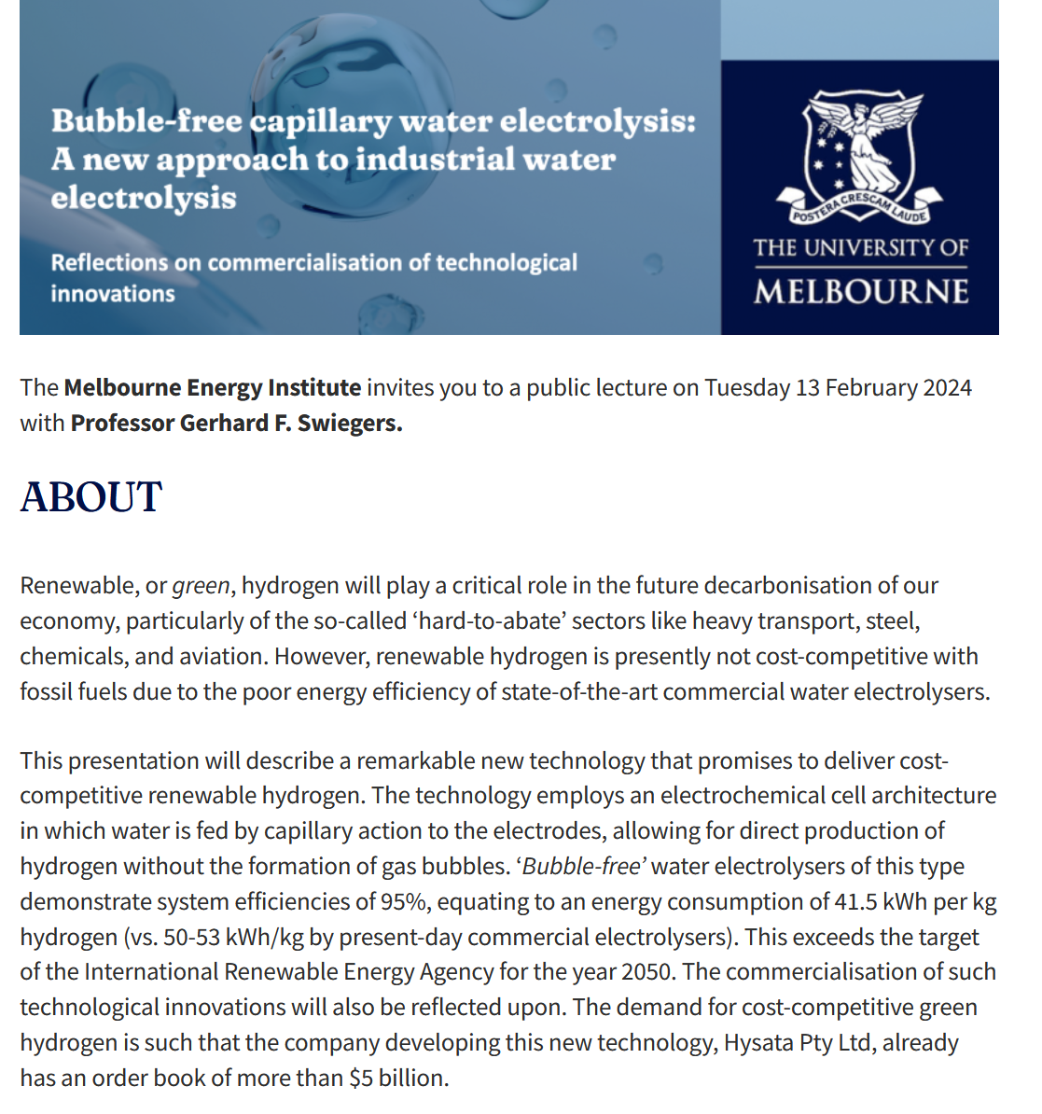
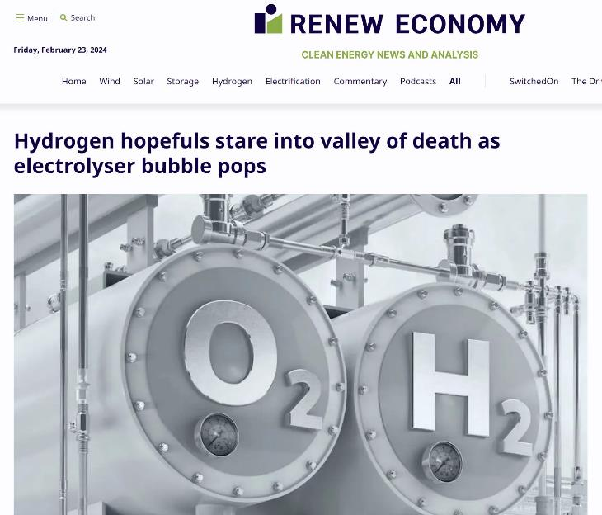
New developments in H₂ power
New electrolyser technique converts electric energy to H₂ energy at 95% efficiency compared to previous 80%
Commercialisation looking good!
BUT?

Slide 35
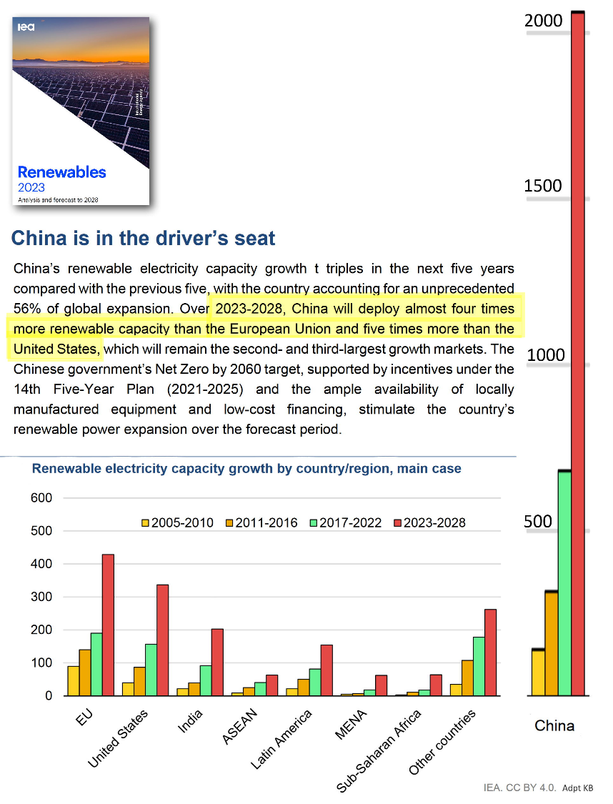
Don’t complain about China!
Our efforts are pathetic in comparison
In 2017-2022 they added 650 GW of renewables, we added about 15 GW
Australia
Notes:
The 15 GW is an estimate from gov data e.g. https://www.cleanenergyregulator.gov.au/Infohub/Markets/Pages/qcmr/december-quarter-2022/State-of-Total-Renewables.aspx
That’s 43 times as much as us. Ok, their population is about 50 times as much but their energy use per person is only about half ours and much of that is to make the stuff we buy.
And we have much more renewable capacity and more wealth.

Slide 36
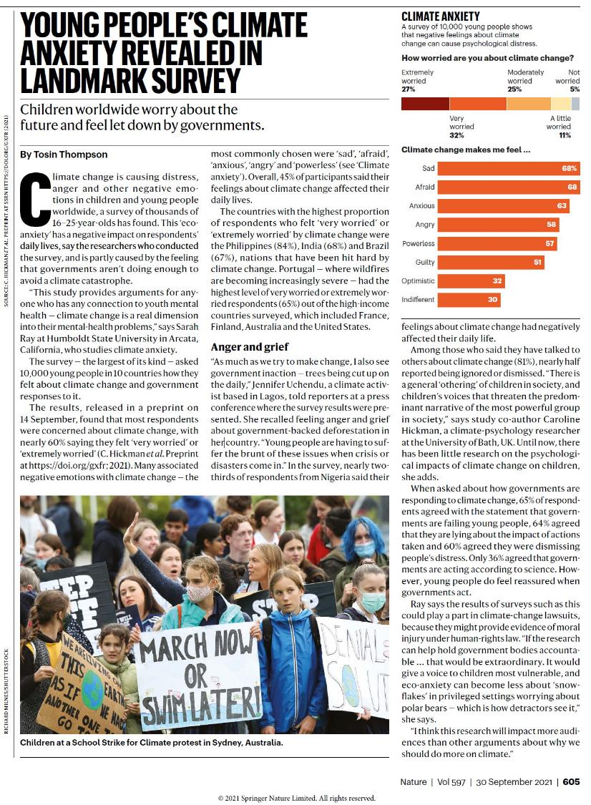
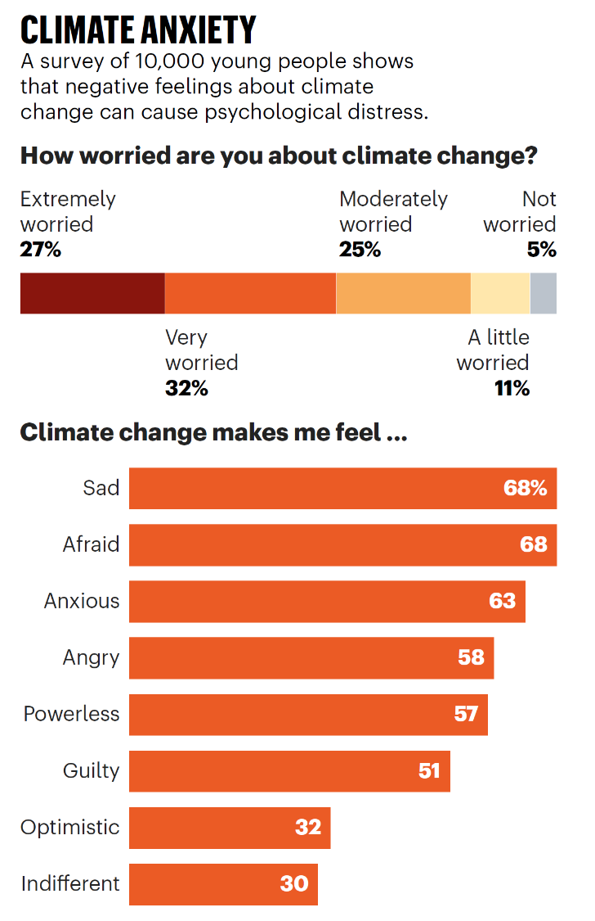

Slide 37
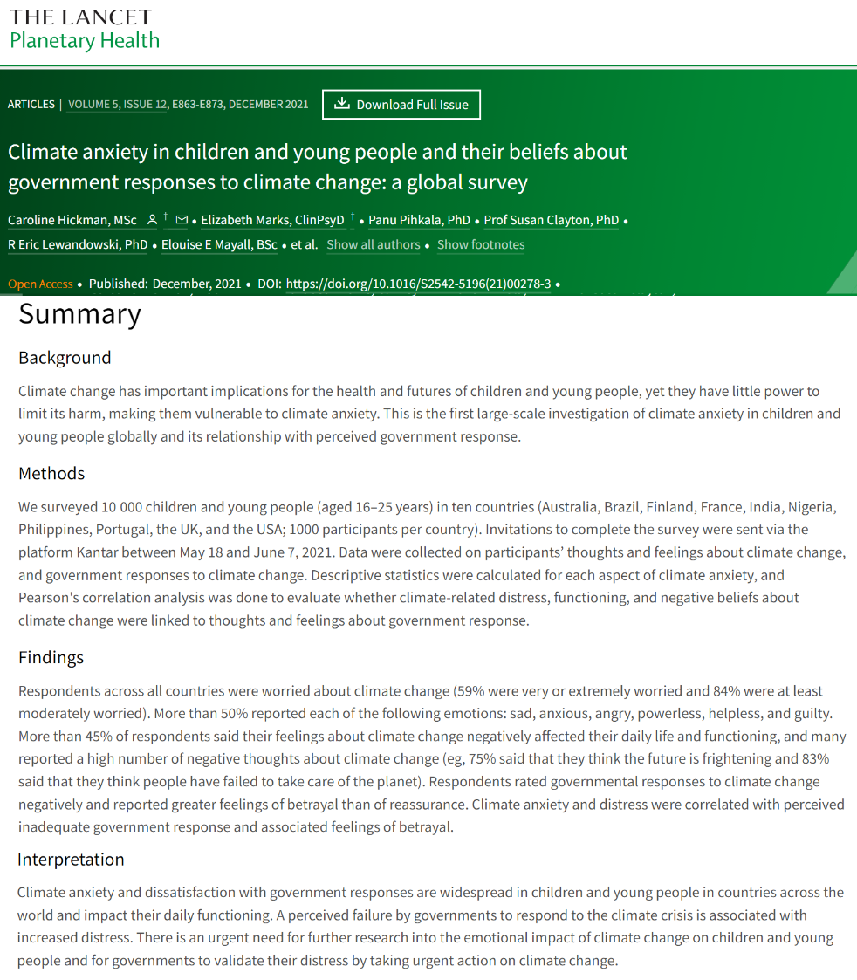
Interpretation
Climate anxiety and dissatisfaction with government responses are widespread in children and young people in countries across the world and impact their daily functioning. A perceived failure by governments to respond to the climate crisis is associated with increased distress. There is an urgent need for further research into the emotional impact of climate change on children and young people and for governments to validate their distress by taking urgent action on climate change.
Notes:
Interpretation
Climate anxiety and dissatisfaction with government responses are widespread in children and young people in countries across the world and impact their daily functioning. A perceived failure by governments to respond to the climate crisis is associated with increased distress. There is an urgent need for further research into the emotional impact of climate change on children and young people and for governments to validate their distress by taking urgent action on climate change.
https://www.thelancet.com/journals/lanplh/article/PIIS2542-5196(21)00278-3/fulltext
Summary
Background Climate change has important implications for the health and futures of children and young people, yet they have little power to limit its harm, making them vulnerable to climate anxiety. This is the first large-scale investigation of climate anxiety in children and young people globally and its relationship with perceived government response.
Methods We surveyed 10 000 children and young people (aged 16–25 years) in ten countries (Australia, Brazil, Finland, France, India, Nigeria, Philippines, Portugal, the UK, and the USA; 1000 participants per country). Invitations to complete the survey were sent via the platform Kantar between May 18 and June 7, 2021. Data were collected on participants’ thoughts and feelings about climate change, and government responses to climate change. Descriptive statistics were calculated for each aspect of climate anxiety, and Pearson’s correlation analysis was done to evaluate whether climate-related distress, functioning, and negative beliefs about climate change were linked to thoughts and feelings about government response.
Findings Respondents across all countries were worried about climate change (59% were very or extremely worried and 84% were at least moderately worried). More than 50% reported each of the following emotions: sad, anxious, angry, powerless, helpless, and guilty. More than 45% of respondents said their feelings about climate change negatively affected their daily life and functioning, and many reported a high number of negative thoughts about climate change (eg, 75% said that they think the future is frightening and 83% said that they think people have failed to take care of the planet). Respondents rated governmental responses to climate change negatively and reported greater feelings of betrayal than of reassurance. Climate anxiety and distress were correlated with perceived inadequate government response and associated feelings of betrayal.

Slide 38
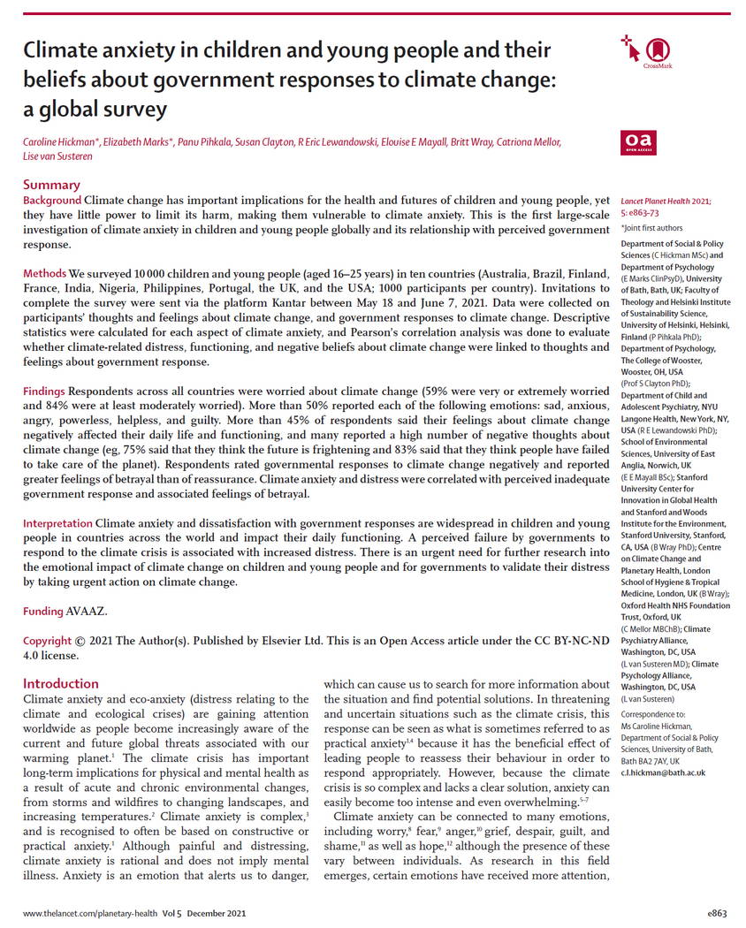
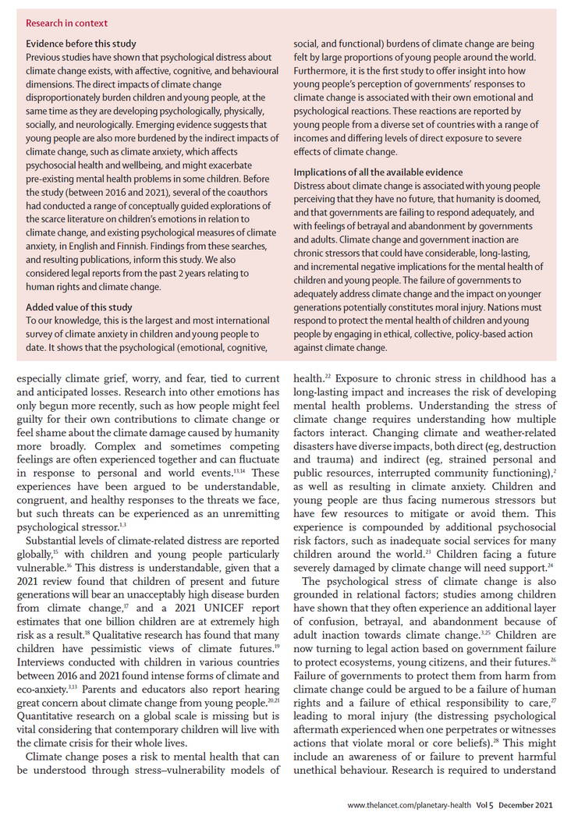
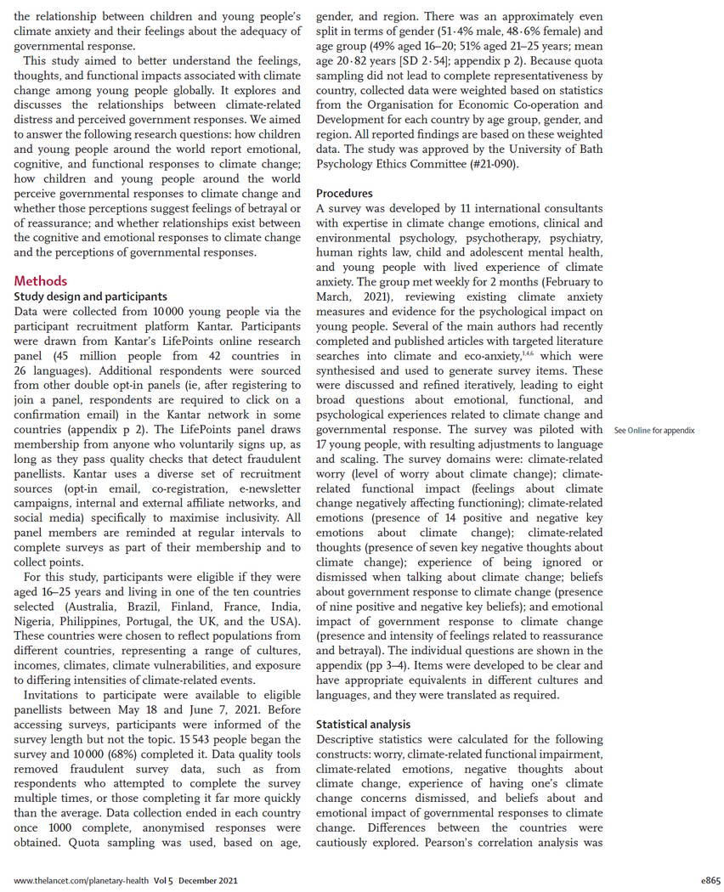
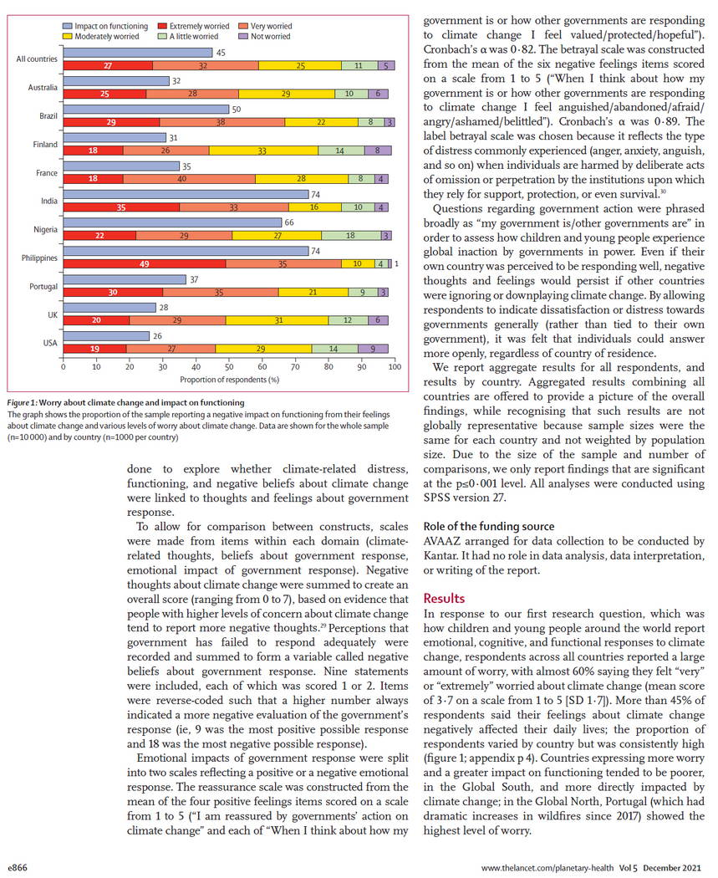
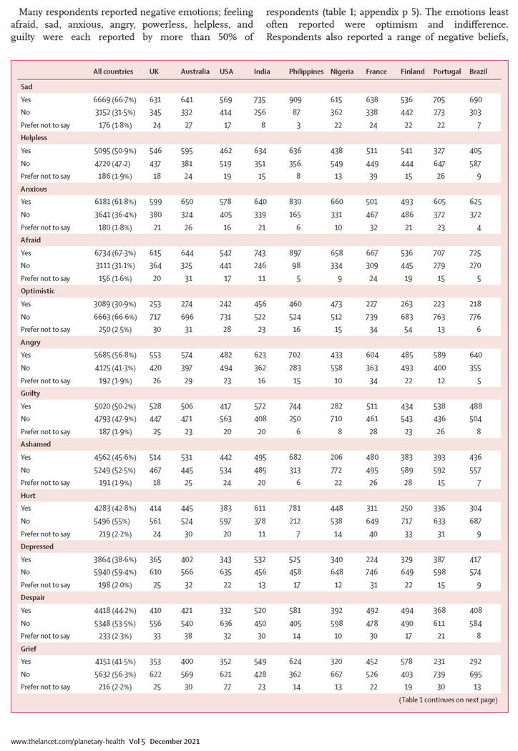
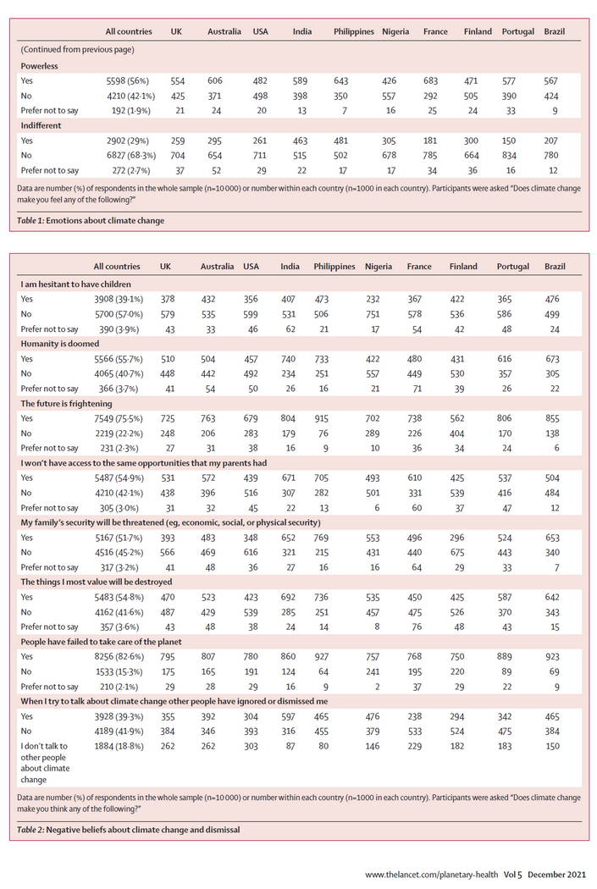
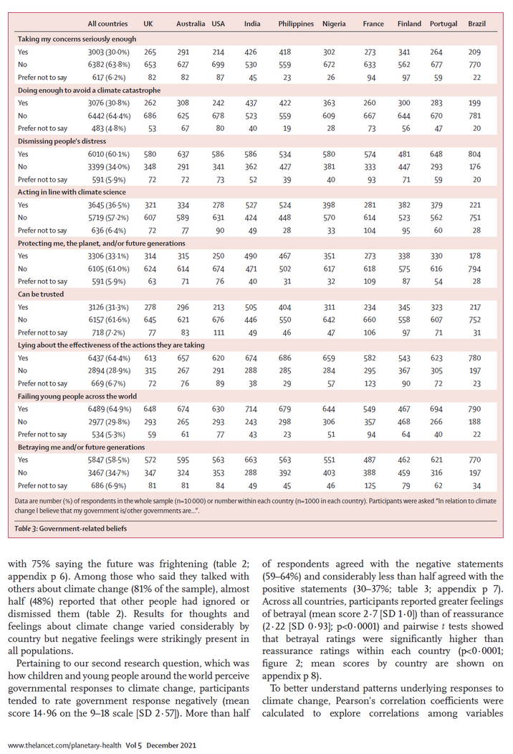
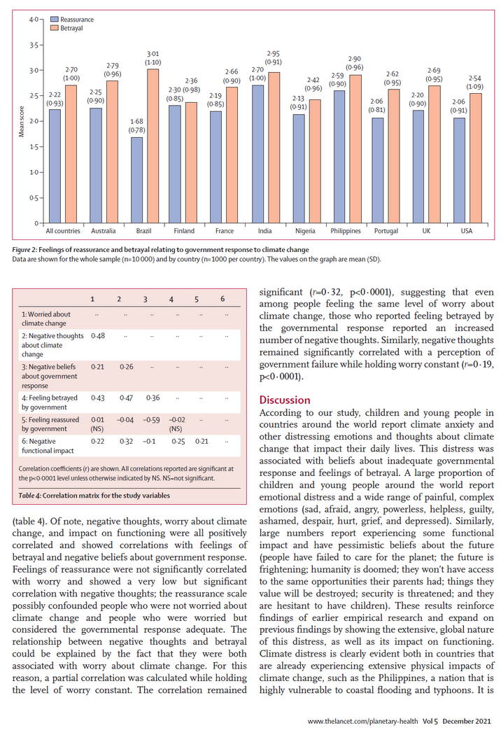
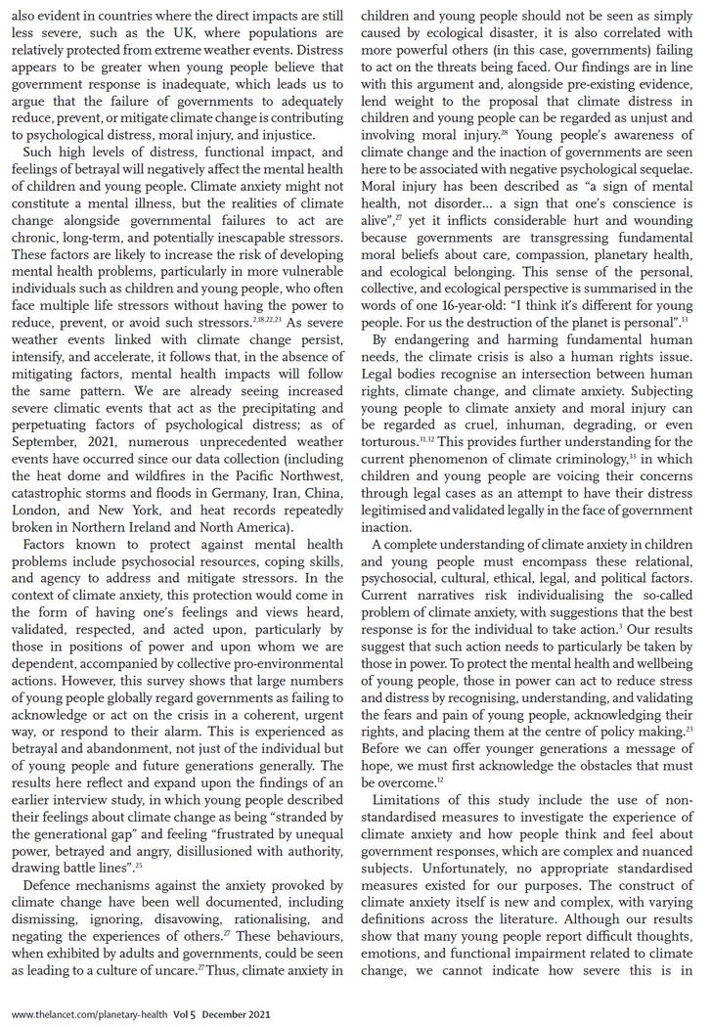

Slide 40
Perhaps curiously the “Impact on functioning” seems less in the more developed nations?

Slide 41
So what’s happening in education
Not a lot of resources on this! (Although a fair bit of “waffle”)
A couple of good books (but $$)
Links to them in the notes
Notes:
Links to books: Children and Climate Change (Abt $30 ebook) [I can lend you a copy if you email me keithphysics@optusnet.com.au]
https://www.cambridge.org/core/elements/abs/children-and-climate-change/B929244F274C8AB6E7E6B1E76456547D
Education in times of environmental crises (abt $75 ebook)
https://www.routledge.com/Education-in-Times-of-Environmental-Crises-Teaching-Children-to-Be-Agents/Winograd/p/book/9781138944367

Slide 42
From Children and Climate Change:
The different responses to climate change
“Emotion focussed coping”
“Problem focussed coping”
“Meaning focussed coping”

Slide 43
From Children and Climate Change:
The different responses to climate change
“Emotion focussed coping”
distraction
avoidance
change the subject, look elsewhere
Helps avoid bad feelings
But doesn’t help achieve anything useful

Slide 44
From Children and Climate Change:
The different responses to climate change
“Problem focussed coping”
solve the problems causing the stress by individual action
ride to school
recycle etc.
Feels better doing something
But can lead to feelings of futility and reduced well-being

Slide 45
From Children and Climate Change:
The different responses to climate change
“Meaning focussed coping”
What can I do about this?
Look for positives – we are building renewables
cultivate trust in scientists, environmentalists, politicians…

Slide 46
From Children and Climate Change:
The different responses to climate change
Emotion Problem Meaning
Less children tended to use meaning strategies than the other two
Older children less than younger ones.
But those who did reported greater well-being and satisfaction because of their engagement in positive action.

Slide 47
So how do we deal with these different approaches?
We need to ask kids how they feel about climate issues.
Discussion can help them sort out their own feelings
Perhaps move them from ‘emotion’ to ‘problem’ and maybe to ‘meaning’

Slide 48
RMIT University (Melbourne)
Southern Cross University (Lismore)
Link and full abstract in Notes section
Notes:
https://www.tandfonline.com/doi/full/10.1080/14733285.2019.1614532
Abstract: The reality of anthropogenic climate change has been established ‘beyond reasonable doubt’ by leading scientists worldwide. Applying a systematic literature review process, we analysed existing literature from 1993-2014 regarding climate change education for children and young people, with the aim of identifying key areas for further research and innovation in the field. While a number of studies have indicated that children and young people’s understandings of climate change are generally limited, erroneous and highly influenced by mass media, other studies suggest that didactic approaches to climate change education have been largely ineffectual in affecting students’ attitudes and behaviour. The review identifies the need for participatory, interdisciplinary, creative, and affect-driven approaches to climate change education, which to date have been largely missing from the literature. In conclusion, the authors call for the development of new forms of climate change education that directly involve children and young people in responding to the scientific, social, ethical, and political complexities of the issue.

Slide 49
A Systematic Review of Climate Change Education: Giving Children and Young People a ‘Voice’ and a ‘Hand’ in redressing Climate Change
From the ABSTRACT:
A number of studies have indicated that young people’s understandings of climate change are generally limited, erroneous and highly influenced by mass media
Other studies suggest that didactic approaches to climate change education have been largely ineffectual
The review identifies the need for participatory, interdisciplinary, creative, and affect-driven approaches to climate change education
We call for the development of new forms of climate change education that directly involve young people in responding to the scientific, social, ethical, and political complexities of climate change.
Notes:
NB: The full article requires subscription, but I can lend it to if you email me.
Abstract: The reality of anthropogenic climate change has been established ‘beyond reasonable doubt’ by leading scientists worldwide. Applying a systematic literature review process, we analysed existing literature from 1993-2014 regarding climate change education for children and young people, with the aim of identifying key areas for further research and innovation in the field. While a number of studies have indicated that children and young people’s understandings of climate change are generally limited, erroneous and highly influenced by mass media, other studies suggest that didactic approaches to climate change education have been largely ineffectual in affecting students’ attitudes and behaviour. The review identifies the need for participatory, interdisciplinary, creative, and affect-driven approaches to climate change education, which to date have been largely missing from the literature. In conclusion, the authors call for the development of new forms of climate change education that directly involve children and young people in responding to the scientific, social, ethical, and political complexities of the issue.

Slide 50
A “must have” for all school libraries

Slide 52
So what to do?
Encourage those who are concerned to get together and discuss action they can take – form a ‘club’?
Support those groups with good information
Talk to whole staff, and individuals, about the issue and the science, get them on side, particularly about –
the basic science of climate change
the consequences of global heating
the dangers of tipping points
the lack of sufficient action from politicians
the misinformation from the Murdoch and other media
getting a guest scientist to talk to Years 11 & 12

Slide 53
Some Resources that might be useful
The following websites may be of use. I have looked for those which discuss climate change and its’ effects rather than those that concentrate simply on “environment”.
Do you have others that could be helpful?

Slide 54
The Victorian Climate Action Network has a large number of groups and sites – many may be useful but a lot won’t be.
https://vcan.net.au/find-a-group/

Slide 55
Mostly about Environmental Education, but seems to have some climate change relevant material

Slide 56
Australian Youth Climate Coalition
Activity varies somewhat
https://www.switchedonschools.org.au/
https://www.aycc.org.au/
Notes:
We are the Australian Youth Climate Coalition
The Australian Youth Climate Coalition is Australia’s largest youth-run organisation, our mission is to build a movement of young people leading solutions to the climate crisis.
Young people have the most to lose from climate change, but we also have a lot to gain. Climate change is our best opportunity to create a world that works for everyone, not just a few. We can power our lives with the wind and sun, and ensure access to clean energy and job opportunities for all.

Slide 57
The Climate Council is a very good source of information, but doesn’t have much about education
https://www.climatecouncil.org.au/
Notes:
Climate Council is Australia’s own independent, evidence-based organisation on climate science, impacts and solutions.
We connect decision-makers, the public and the media to catalyse action at scale, elevate climate stories in the news and shape the conversation on climate consequences and action, at home and abroad.
We advocate for climate policies and solutions that can rapidly drive down emissions, based on the most up-to-date climate science and information.
We do this in partnership with our incredible community: thousands of generous, passionate supporters and donors, who have backed us every step of the way since they crowd-funded our beginning as a non-profit organisation in 2013.

Slide 58
This looks like a useful resource, lots of links:
“The Climate Change Education Network is a community of allied academics from across Australia who are passionate about climate change education.”
https://climatechangeeducation.net.au/climate-change-education-resources/
Notes:
The Climate Change Education Network is a community of allied academics from across Australia who are passionate about climate change education.
We are interested in exploring climate change education practice through teaching and research. We have broader aim to create an active response to the climate crisis by addressing the lack of climate change pedagogy and curriculum in educational settings. Our intention had been to find connection and support each other during challenging times, since finding that our community and connections sustain us in our work. We are a productive and supportive collective who meet monthly to talk about climate change education and our ongoing projects.

Slide 59
Nearly half of global youth surveyed (45%) say climate anxiety and distress is affecting their daily lives and functioning
https://www.bath.ac.uk/announcements/government-inaction-on-climate-change-linked-to-psychological-distress-in-young-people-new-study/
Notes:
Doubt that number in Australia would agree??
Nearly half of global youth surveyed (45%) say climate anxiety and distress is affecting their daily lives and functioning - according to results from the largest scientific study into climate anxiety in children and young people, according to new research.
The inaugural study, based on surveys with 10,000 children and young people (16-25) across 10 countries, found 75% of young respondents believe ‘the future is frightening’ - jumping to 81% of youth surveyed in Portugal and 92% in the Philippines. It found, for the first time, that climate distress and anxiety is significantly related to perceived government inaction and associated feelings of betrayal. 58% of children and young people surveyed said governments were “betraying me and/or future generations,” while 64% said their governments are not doing enough to avoid a climate catastrophe.
Link to the study
Climate anxiety in children and young people and their beliefs about government responses to climate change: a global survey Author links open overlay panelCaroline Hickman
https://www.sciencedirect.com/science/article/pii/S2542519621002783

Slide 60
This project was created with and for young people who are concerned about climate change, along with researchers from the University of Melbourne.
“The co-designers said young people want opportunities to share these experiences and learn from each other, and for adults to genuinely engage with them”
https://climatesuperpowers.org/climate-superpowers
Notes:
https://climatesuperpowers.org/climate-superpowers
This website was created through the Young People’s Climate Change Superpowers project, which aimed to support children and young people to share their wisdom and creativity in dealing with climate change.
YOUNG PEOPLE’S CLIMATE CHANGE SUPERPOWERS PROJECT
It was created with and for young people who are concerned about climate change, along with researchers from the University of Melbourne. It highlights the strengths and assets that young people have, and how these can be drawn upon and developed to help young people navigate the climate crisis.
The project also established an agenda for future work on this topic and connected young people, supporting them to develop their skills and contribute to research.
This project was funded by a Climate Research Accelerator Grant from Melbourne Climate Futures at the University of Melbourne.
“The co-designers said young people want opportunities to share these experiences and learn from each other, and for adults to genuinely engage with them.”

Slide 61
This
Notes:
Focusses on 7 different aspects of dealing with climate change.

Slide 62
Just a few of the many suggestions:
Notes:
There are a lot more suggestions, many with links to helpful websites https://climatesuperpowers.org/climate-superpowers
Solastalgia: the distress caused by environmental change
“How do I deal with climate anxiety” is a link to another page which has further links to a number of external sites which can help kids with anxiety.

Slide 63
Notes:
There are a lot more suggestions, many with links to helpful websites https://climatesuperpowers.org/climate-superpowers
Solastalgia: the distress caused by environmental change
“How do I deal with climate anxiety” is a link to another page which has further links to a number of external sites which can help kids with anxiety.
Climate for Change was mentioned twice – it’s another useful site – coming up

Slide 64
Well worth a read to see how Climate Superpowers was developed
Notes:
https://theconversation.com/what-am-i-supposed-to-do-about-all-this-really-bad-stuff-young-people-identify-7-superpowers-to-fight-climate-change-193620

Slide 65
Climate for Change, or C4C, is a useful organisation which runs “Conversations” in people’s homes. Kids could organise one for their home!
The website also has useful material including ...

Slide 66
... suggestions for interacting with MPs
An activity which can help ‘empower’ kids!
https://www.climateforchange.org.au/mpegs_resources

